Slide 1
Appearance Enhancement of Hair Mask and Serum
Avik Ghosh

Slide 2
Project Charter
Tutor Name | Supriya Punyani/Ashwini Sadawarte
Location | Mumbai
Project objective What is it? Why is it important? | Develop different appearance and texture of the mask and serums in hair care to delight the consumer. It is important as mask and serums in hair care are exploding in market however all of them look same and consumer are not able to differentiate them..
Key deliverables/milestones What do we have to produce? e.g. reports, analyses, methodologies What will the trainee implement? | 1-2 prototypes which are consumer delightful vs competitor in terms of appearance, texture and benefit space. Scalable prototype at factory level Documenting formula card and also bpr capturing all process Sharing and presenting the results to core team Trainee will implement the category knowledge, formulation basics, success criteria, evaluation methodology (technical and consumer) and also data interpretation for decision making
Success criteria How will we know if it is successful? What are the key KPIs? | 1-2 prototypes which are consumer delightful vs current in-market and competitor in terms of appearance and texture Scalable prototype at factory level
Team members Who will be key stakeholders for the trainee? | Dove Brand Team, Product Supply Chain

Slide 3
Understanding Hair Mask and conditioner:
Def:
Conditioner or hair mask is a product that used for aiding/ease the detangling of wet hair and dry hair that is the cause of hair damage by frictional mechanics.
Main Ingredients:
Cationic Surfactant: CTAC, BTAC
Fatty Alcohol: Cetyl Alcohol, Ginol 16:18 TA
Fat Phase: Cetyl Palmitate, Parafin wax, Stearyl stearate
Silicone: Dimethicones, Amodimethicones and cyclomethicones

Slide 4
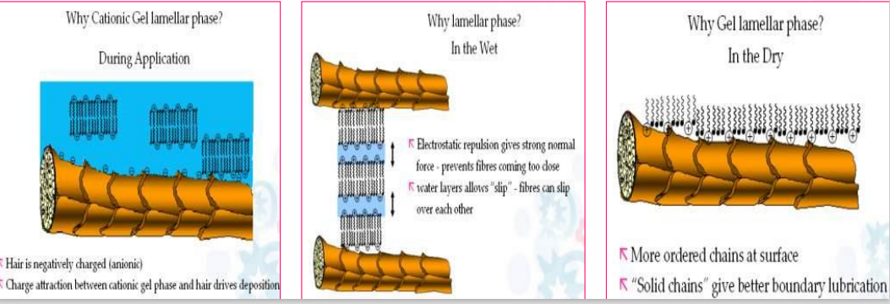
Mapping the ingredients to their functions:
Cationic Surfactant: → why do the hair fiber carry a negative charge? How they get deposited? Why are they important? Can we make without them?
→ At low ph environment, offers easy absorption on the negatively charged hair fibre and repulsion of adjacent positive charge.

Slide 5
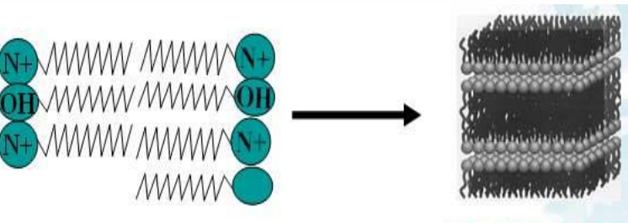
Fatty Alcohol:
Forms the lamellar gel phase via hydrophobic interaction of alkyl chains and enables uniform deposition of Quats

Slide 6
Silicone Emulsion:
Deposition of silicone improves smoothness and make the hair fiber shiny.
Higher MW silicone improves the deposition
Amino silicones are charged like the Quats and hence improve the deposition.
Improve smoothness and offer shine
Fat Phase:
To control the viscosity and rheology

Slide 7
Process Outline of Hair Mask:
There are four main steps to prepare hair mask with the lamellar sheet structure:
1)Melting:
BTAC, FA and any fat phase in a side pot and melt the mix at temperature of 80-85C
Stir it till it results in a clear liquid.
2)Primary mixture:
In the main pot, addition of water, lactic acid, color maintaining the temperature.
Pour the melted mix of first stage and mix it with high rpm (5000-6000) with a good scrapping for about 30 min to make the emulsion.
3)Quenching:
Add water of temperature 18-20C slowly into the main pot
4)Addition of other ingredients:
Add the other materials like silicone, preservatives, perfume one by one.

Slide 8
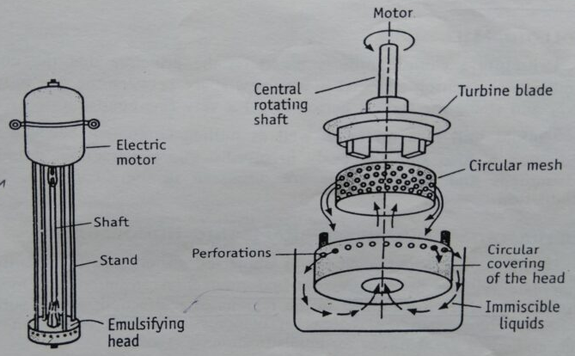
Design of Homogenizer :
In the lab scale homogenizer as it is shown in
the picture the product need to be passed
through those small holes and by that
process the final product gets well mixed and
at about 2-5 micron of size

Slide 9
Formulation details:
Worked with 2 formulations → 1. DV IR (HB50+ 2% LadyBird + Sodium benzoate)
2. DV DS (HU25 + 2.5% amino shield + 0.5% cetyl palmitate)
Formulation tables here…

Slide 10

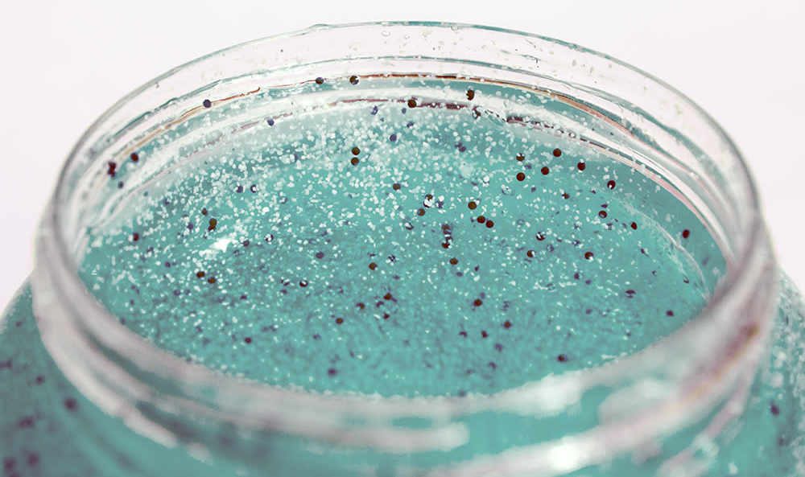
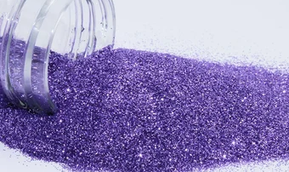
Routes for appearance enhancement
Beads / pearls/ encapsulates
Shimmers & Glitters
Colour – Dual / more shades in a pack

Slide 11

Challenges & constraints
Colour – Dual / more shades in a pack
Beads / pearls/ encapsulates
Shimmers & Glitters
Mixing of phases in transit
Breaking due to high shear stress while mixing.
Interference with the microsheet structure.
Interference with silicone deposition
Interference with silicone deposition.
Too small size for visibility
Factory level cleaning

Slide 12
Design of a Dual or More shades in one Pack

Slide 13
Benefit to the consumer:
Enhancing appearance for consumer delight.
The dual shade will also help in claims and connect the consumer with the product like Blue → hydration, golden → ,
The problems:
From factory to consumer:
While in transit the two colors can get mixed due to shake and jerks
While In Use:
When the consumer will scoop the product from the tub, it can get mixed

Slide 14
Solution:
- Packaging - tube in tube package.
- Processing – optimizing the rheological parameters
The parameters we need to check:
Density → remains same for both to prevent settlement due to the gravity → using same formulation
Viscosity → 1.5-1.9 times of each other to prevent motion on each other → Use of high shear to get more viscosity

Slide 15
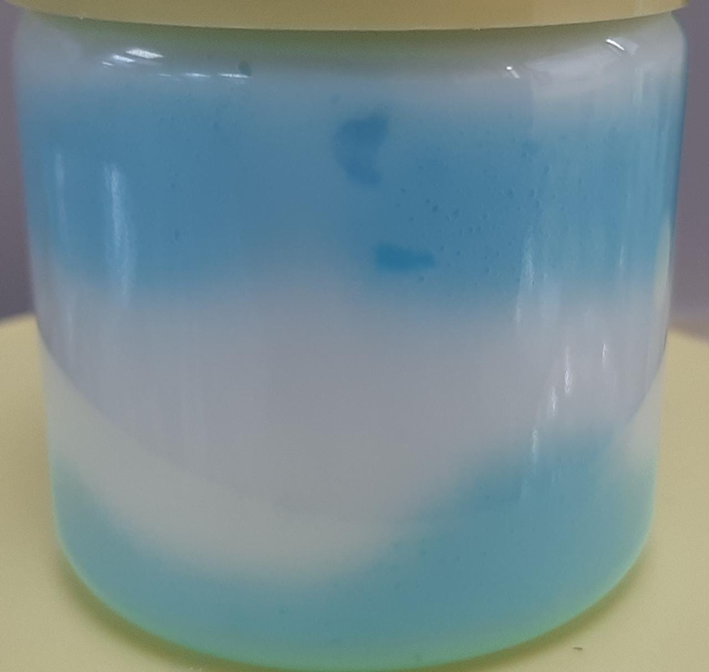
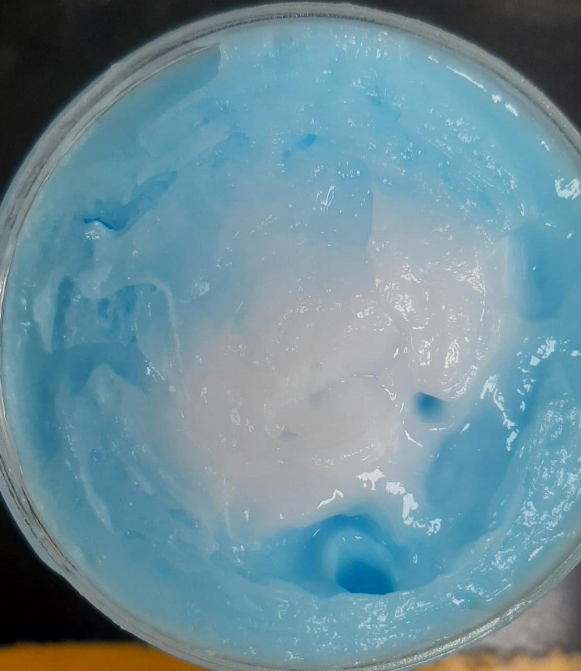
Samples prepared in lab:
I made few samples in the lab by hand putting the mask in zip locks, cut the corner equally and pour them like mehandi
Sample 1:
Mask 1: DV IR(HB50) – color: white – viscosity: 480,000 cp (1.9x)
Mask2 : DV IR(HB50) - color: Blue - viscosity: 250,000 cp.

Slide 16
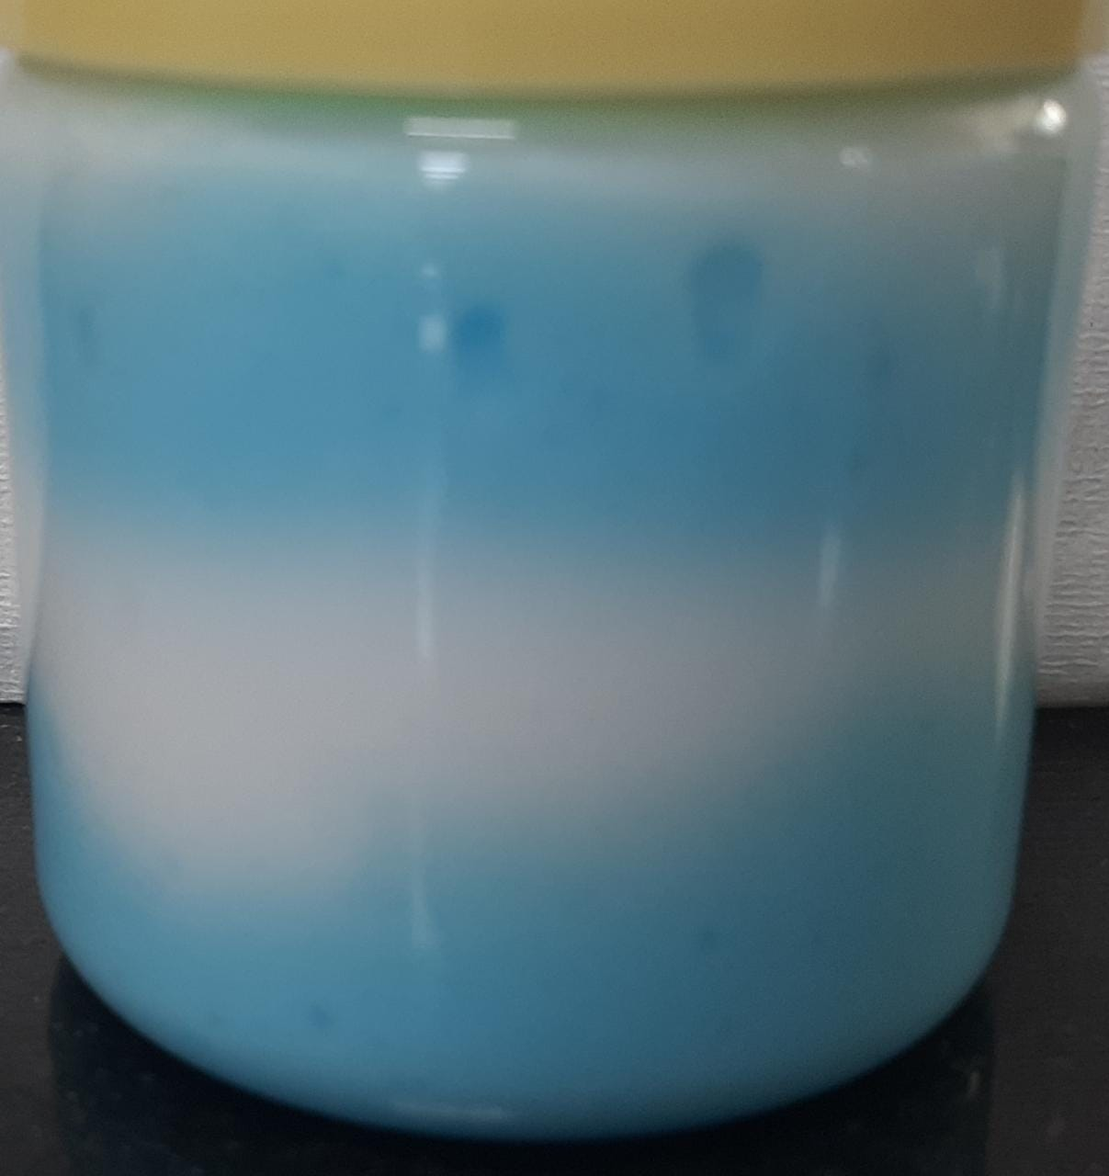
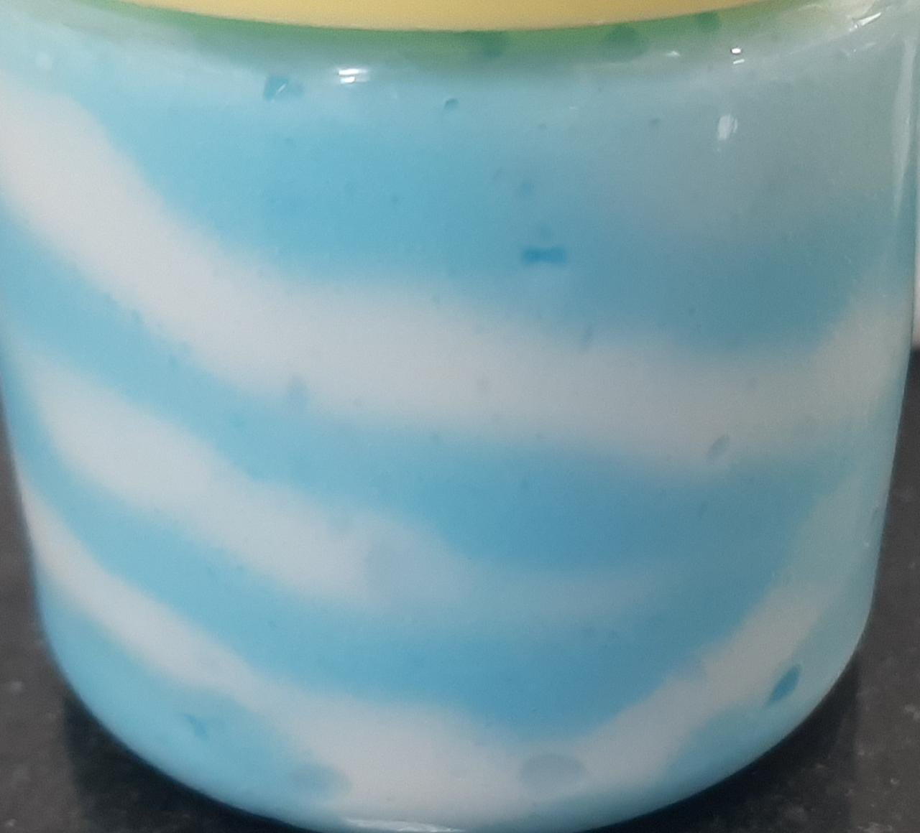
Sample 2:
Mask 1: DV IR(HB50) – color: white – viscosity: 363,000 cp(1.45x)
Mask2 : DV IR(HB50) - color: Blue - viscosity: 250,000 cp.

Slide 17
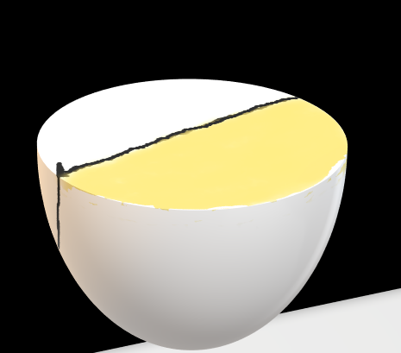
Simpler Version of the Problem:
Pouring half of the tub with one color(preferred to be white) and the other half with another color.
Temporary partition → passing through one conveyor belt and filling one shade →
Passing through another belt and filing the other shade →
Removal of the partition
For opaque tubs, it’s much more easy approach to create a
dual shade.

Slide 18
CTI:
…

Slide 19
Next Steps:
1. Change of Nozzle design
2. Change flow design from the tank to the pipe (bifurcation of flow)
3. Rotating vessel or nozzle

Slide 20
Next Steps:
Explain the theory of mixing and how to prevent it.
Idea with surface tension and others
Ideation of the processing and packaging
How can I check the cross section??
- One of the way to do it is with open cylinder with removable upper and lower lids. You make the product carefully and hold the lids tight to shake it well. The remove the upper lid and the entire cylinder, cut through the middle and check the cross section.

Slide 22
Identify Material & Develop product with shimmer / glitter

Slide 23
What are the consumer benefits the product is supposed to give?
The shimmers or pearls will provide an appealing appearance in the product
As the packaging of most of our masks are in opaque tubs, the product should reflect the same while consumer will rub it in their hands
Further if we can make it deposited on the hair, it should serve a glittery effect on the hair fibre
Problem Statement:
Provide all the benefits mentioned above without changing the sensorial benefits given by the base mask

Slide 25
The Shimmers:
Two type of shimmers
1) Interference: with TiO2 coating and when white light falls on them they reflect only a particular color from the spectrum
2) Coated with color: These have color coating on them

Slide 26
Design of Experiments:
The decisive parameters for the appealing appearance :
Concentration of the shimmer
Size of the shimmer
Type of shimmer
Processing outline:
Make the batch of mask separately.
Add the shimmer of given concentration with DM water and mix it uniformly in the homogenizer(After removing the circular mesh).

Slide 27
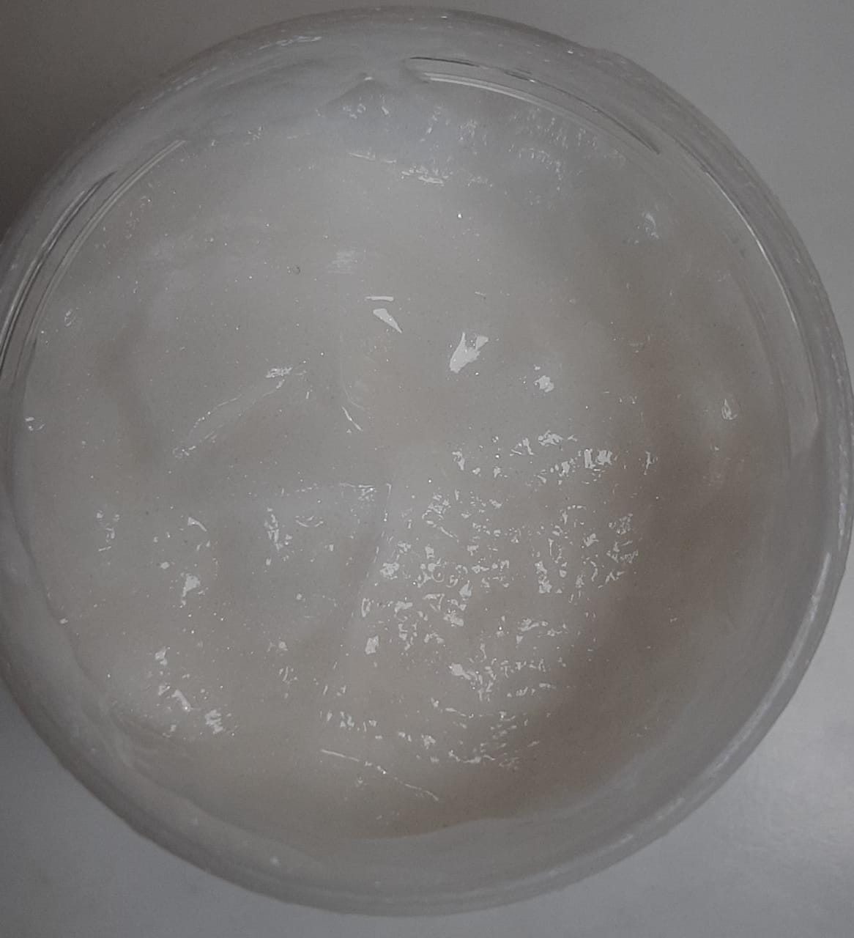
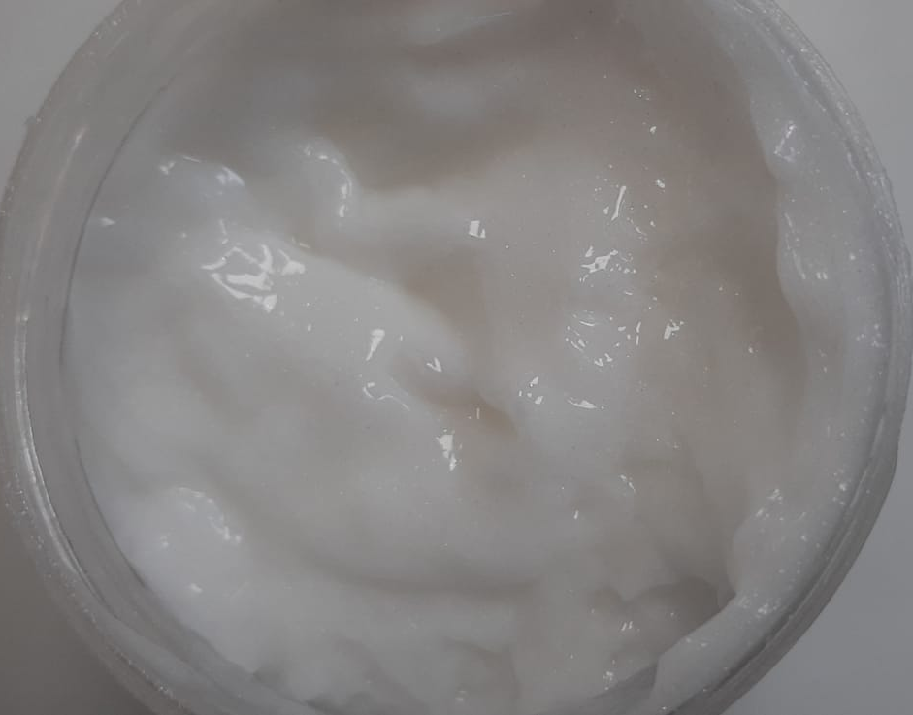
Processing outline:
Make the batch of mask separately.
Add the shimmer of given concentration with DM water and mix it uniformly in the homogenizer(After removing the circular mesh).
Samples with HB50 formulation:
0.5% interference pink 0.5% interference green

Slide 28
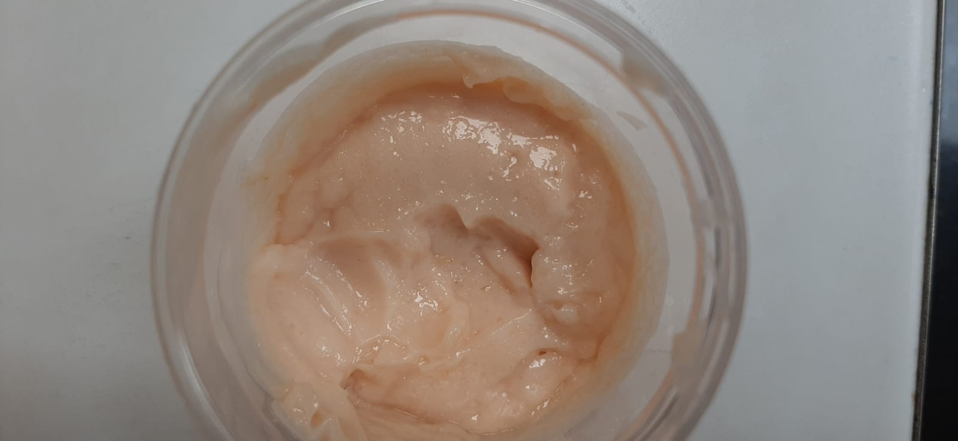
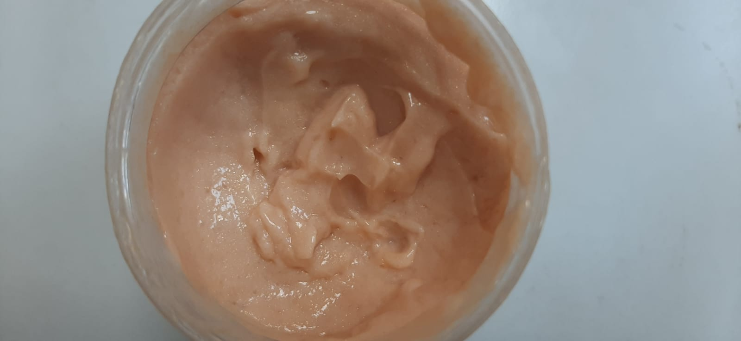
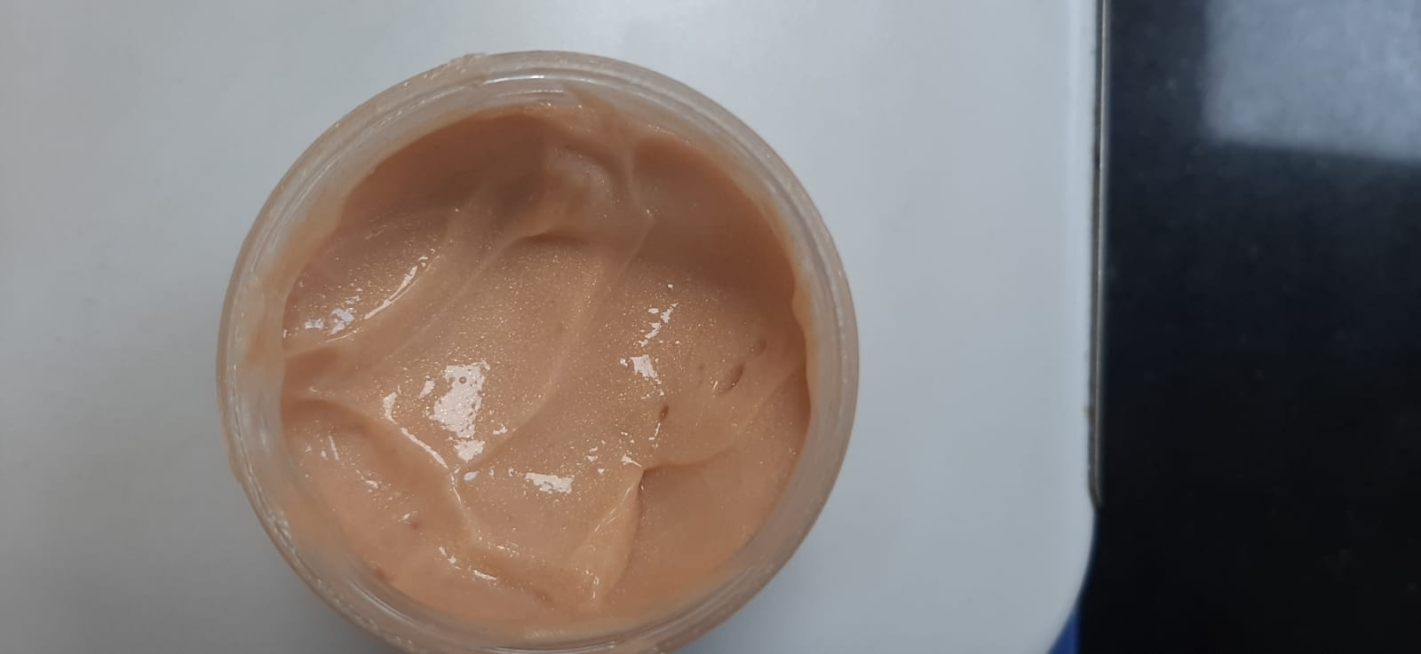
Samples with HB50 formulation:
0.4% Karat Gold MP-24 0.8% Karat Gold MP-24 1% Karat Gold MP-24

Slide 29
Sample with HU25:

Slide 30
CTI RESULTS:

Slide 31
Analysis:

Slide 32
Sensory Test:
Parameters to evaluate:
Ease of dry combing
Frizzfree
Smoothness
Shine
Soft Feel
Test Details:
2 base wash(30s application + 30s wash)
2 non-conditioning wash(30s application + 30s wash)
Mask application(1min application + 2 min leave on + 30s wash)
Constant flow tap water (Sink 2, hair lab)

Slide 33
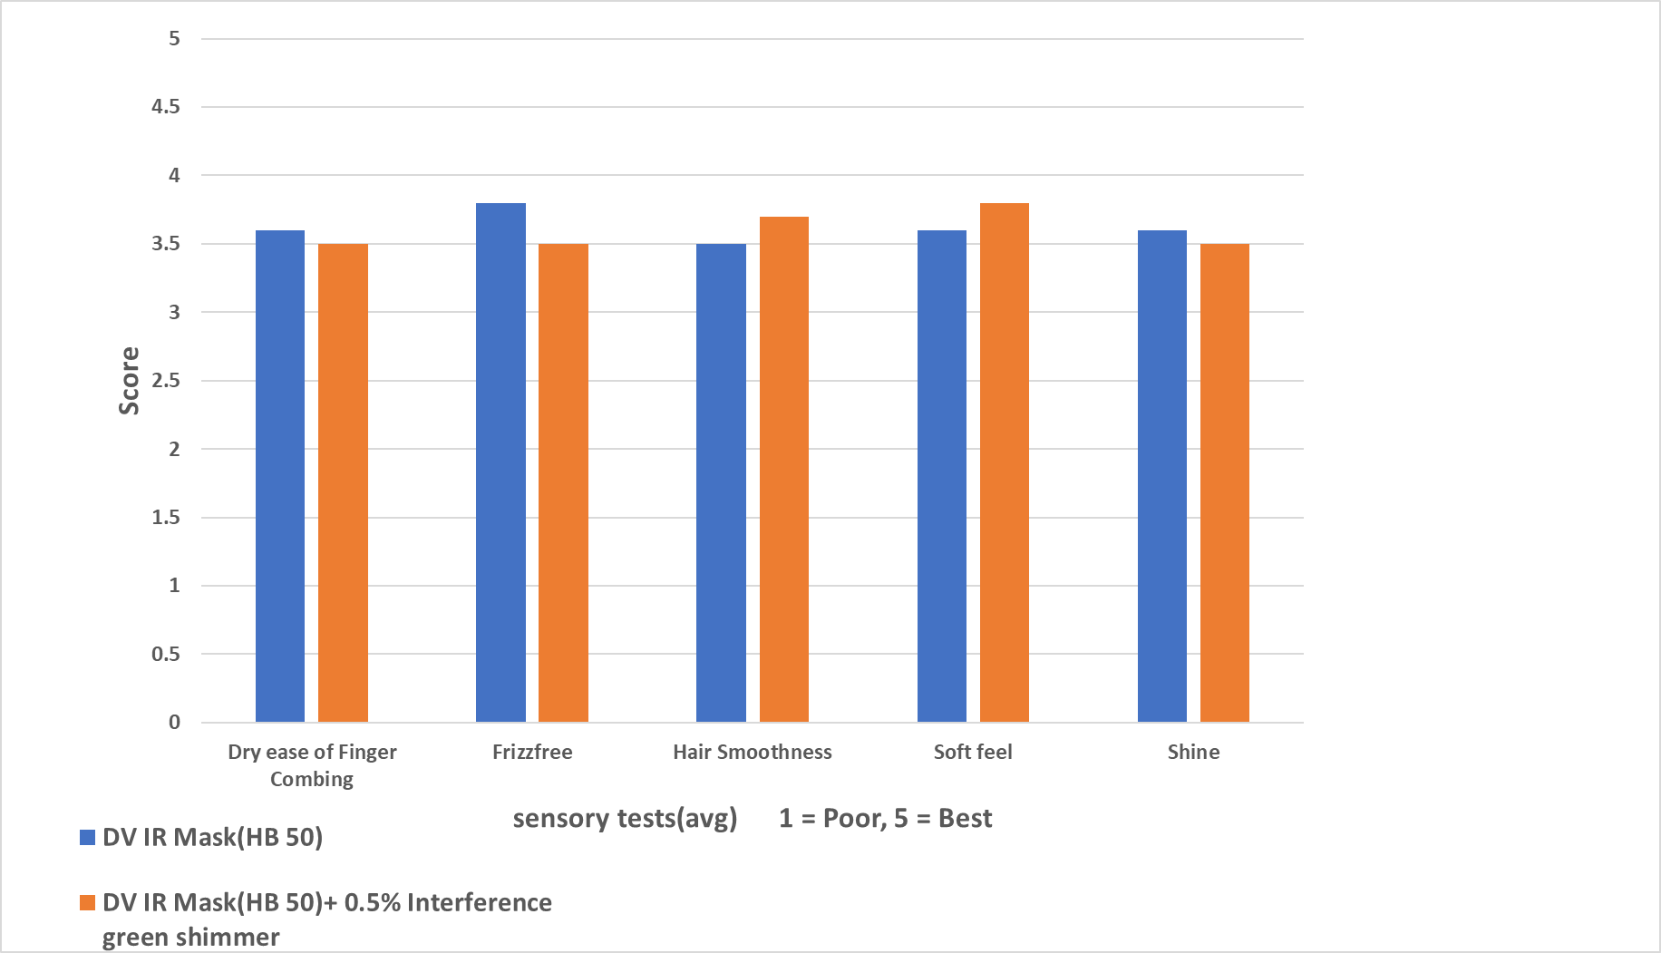
DV IR(HB50) + 0.5% Interference Green:

Slide 34
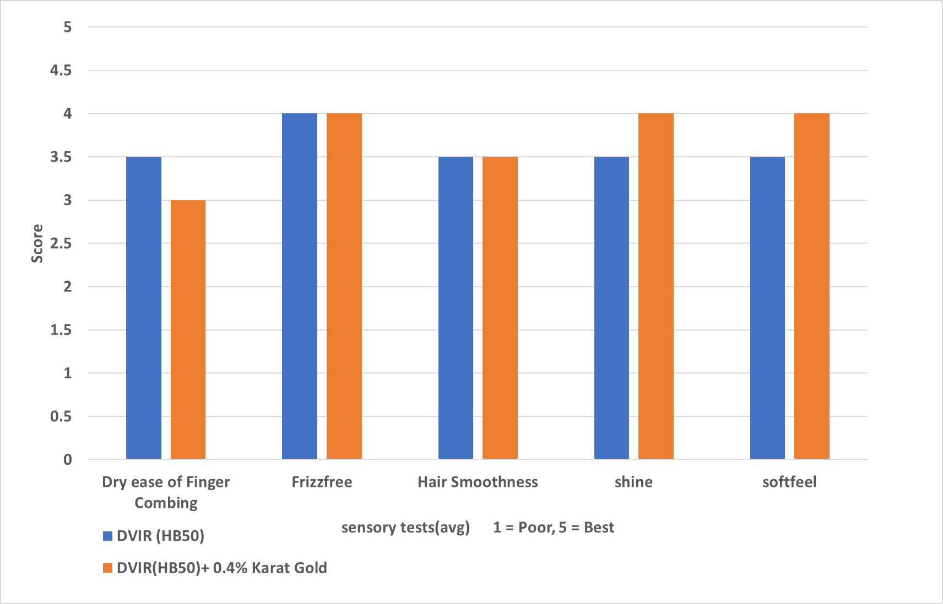
DVIR (HB50) + 0.4% Karat Gold

Slide 35
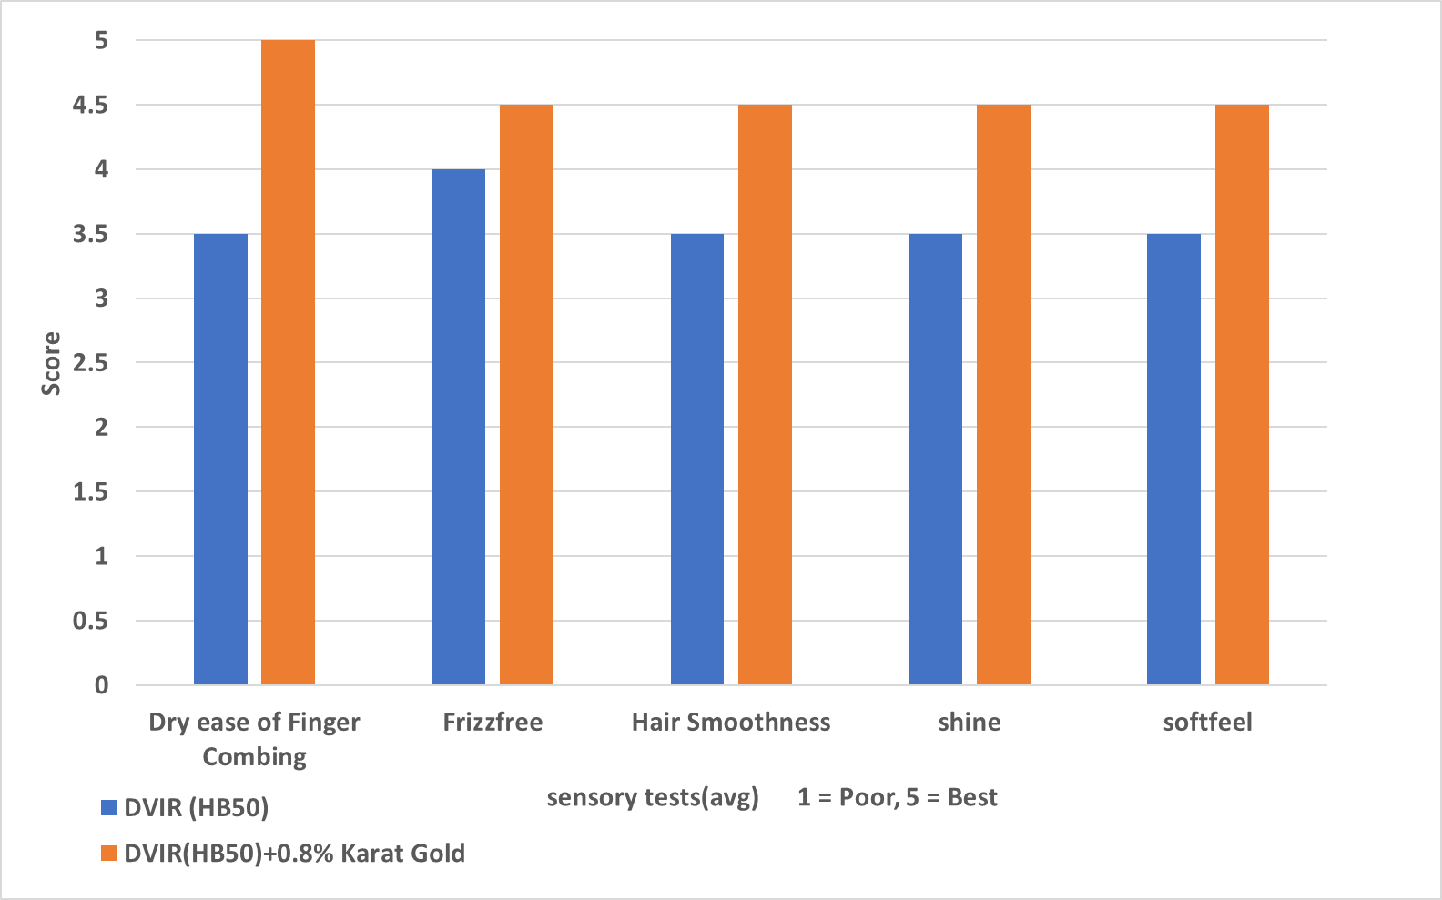
DVIR (HB50) + 0.8% Karat Gold

Slide 36
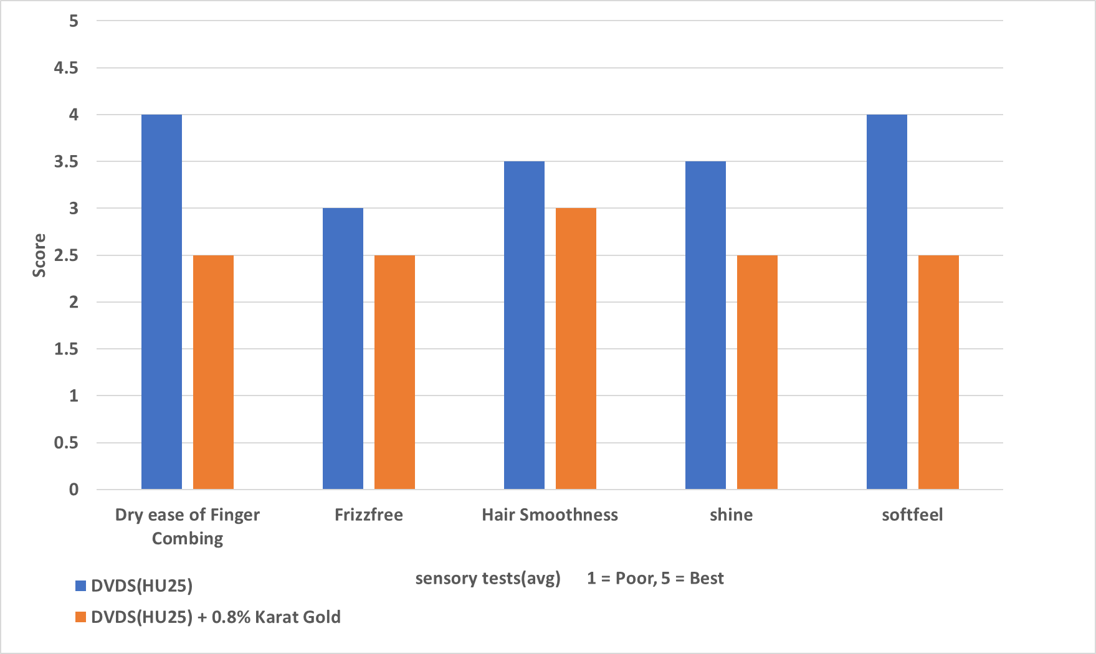
DVDS (HU25) + 0.8% Karat Gold

Slide 37
Analysis of Results:
DV IR Formulation:
This formulation itself is much more concentrated and is provided for deep nourishment. Hence, when mica, TiO2 shimmers are added to it they are easily washed away resulting in less difference in sensory evaluation.
For the borosilicate shimmers, there are more frizz and roughness compared to the product without shimmer.
DV HU Formulation:
This formulation itself is light conditioning compared to the IR formulation
The addition of mica shimmer is giving more frizz and roughness

Slide 38
Observation and Direction:
Mica and TiO2 coated shimmers can be easily washed off as they are hydrophilic, hence selecting these product eventually give small difference in sensory but there won’t be no deposition
With high concentration of shimmer, it is more prone to frizz and roughness. Hence, for the microsheet formulation the concentration must be kept minimum to give the best sensory results.

Slide 39
Explanation :
Reason for roughness and frizz:
The primary reason behind the roughness was suspected to be the silicone deposition. But my theory is the following:
When we are using the mask on the hair fiber, there are portion where the only the shimmers get deposited. So, we can think it as a single line and then a dot of shimmer. This shimmers are getting washed off but now that portion is without or less treatment of mask. That is the reason why we are feeling this roughness.
Interfering with microsheet structure:
- As in the processing the shimmers are added at the later stage. Till then the emulsion and the lamellar structure has already been formed. Now, the gap in the lamellar structure we have 0.9-1 nm between the hydrocarbon chains and 200-500 nm between the sheets. So, it’s very unlikely the shimmer are interfering with the structure.

Slide 40
Ways to verify the explanations:
Microscopic images: CryoSEM, XRF
Experiments:…

Slide 41
Next Steps:

Slide 42
Cost Details:
Tentative cost of shimmer is taken here as 16000/kg.

Slide 43
Ways to Optimize the Cost:

Slide 44
Names:

Slide 45
Identify Material & Develop product with beads/encapsulates

Slide 46
Benefits:
What are the cosumer benefits this product is supposed to give?
- Provide an appealing appearance
Here we have two options in the beads:
Hard microspheres:
If we use hard beads which won’t get crushed while rubbing, this can serve as a purpose of
1) scalp scrubbing 2) Dandruff removal
Soft microspheres:
Here we have more options.
If it is just emollient beads, it can serve sensorial benefits(more smoothness and shine)
if it is encapsulated beads, it can serve the purpose of carriers:
Vit E → nutrients
oil/emollients → shine
perfume → Fragrance
Moreover, as the beads will be visible to the consumer, it will serve as a way for the claims
Compared to polyethylene beads we are using ester and wax beads which …. Competitor stand point

Slide 47
Scouting Beads:
For scouting the right beads, we need to fix the right criterions. They are the following:
As the Ph of hair mask is between 3-5, we need beads which can sustain that Ph level.
The temperature while processing the hair mask use to be in the range of 50-80C. So, we need beads which have some-what high melting point to prevent the risk of melting and getting crushed easily.

Slide 48
After discussing with various suppliers, I’ve collected the following samples:

Slide 49
Processing in lab for samples made with beads:
First the mask is made following the usual process.
In the end, when the temperature of the mask is ambient, the beads are added to it with DM-water.
Different level of mixing(1000-7000 rpm) are tested to verify whether the beads are getting crushed or not.
Result:
-In the lab, after we followed the above processing, the beads didn’t get crashed till 7000 rpm.
-The ring of the homogenizer was removed before mixing the beads.

Slide 50
How much beads should I add?
To optimize the concentration of the beads in the mask, we need to consider some invariants.
Nonetheless the parameters are following:
Number of beads = N, diameter of the beads = d, density of the beads = p , concentration of beads in mask = X
Now, if there is X conc of beads in mask, the number of beads will be given by N ~ X/pd³
If we choose the invariant as the portion without beads in any cross section and assume uniform distribution:
N.d² = constant
X ~ d
That is for small beads we can use low concentration.
So, we have to set some reference X, d and calculate the value of X for any d.
My Ref: X = 0.75% , d = 1mm
Other invariants could be N, N.d

Slide 51
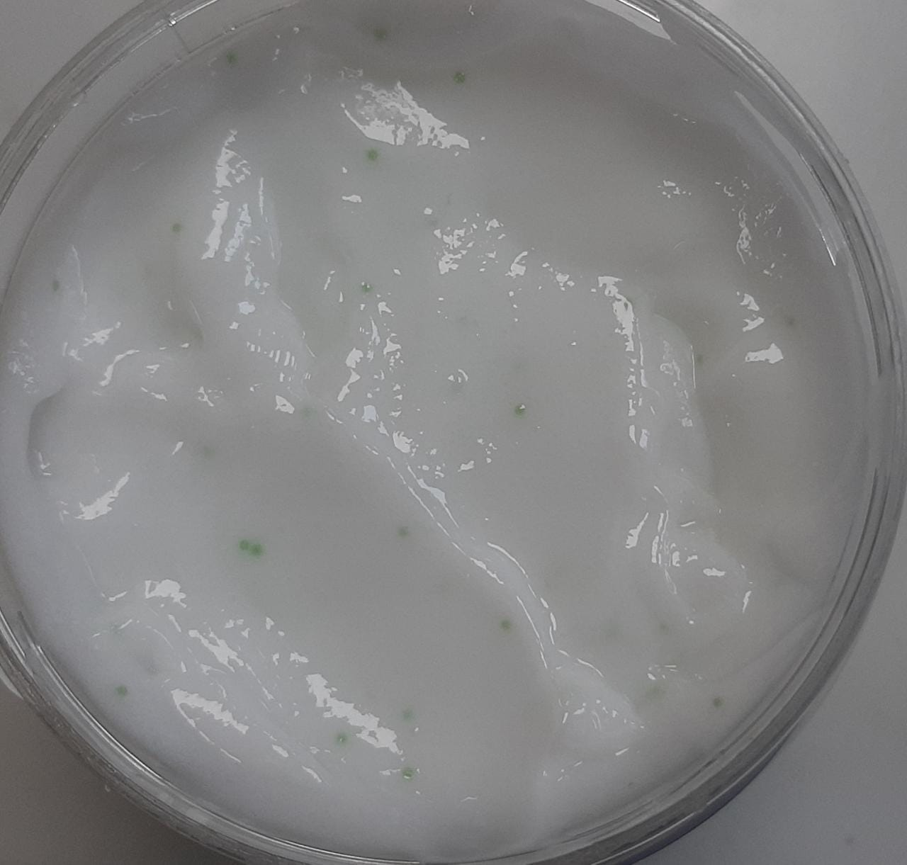
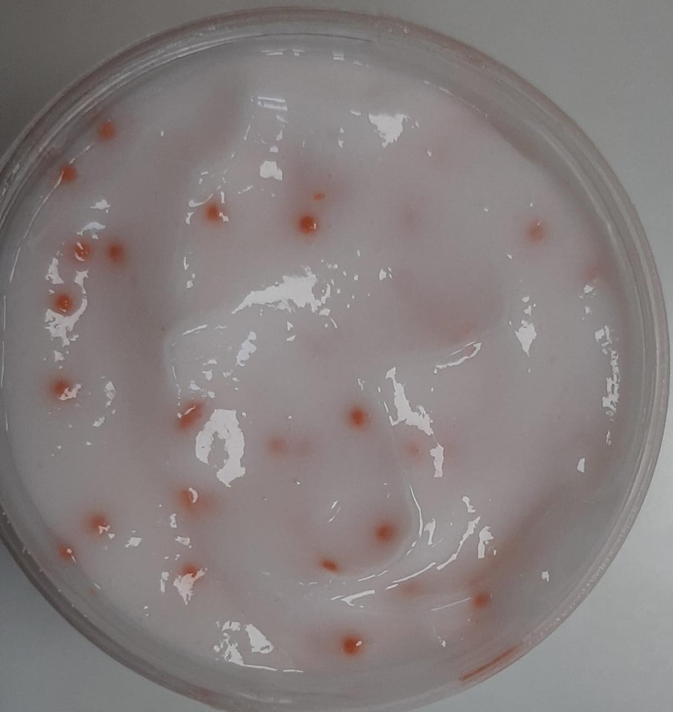
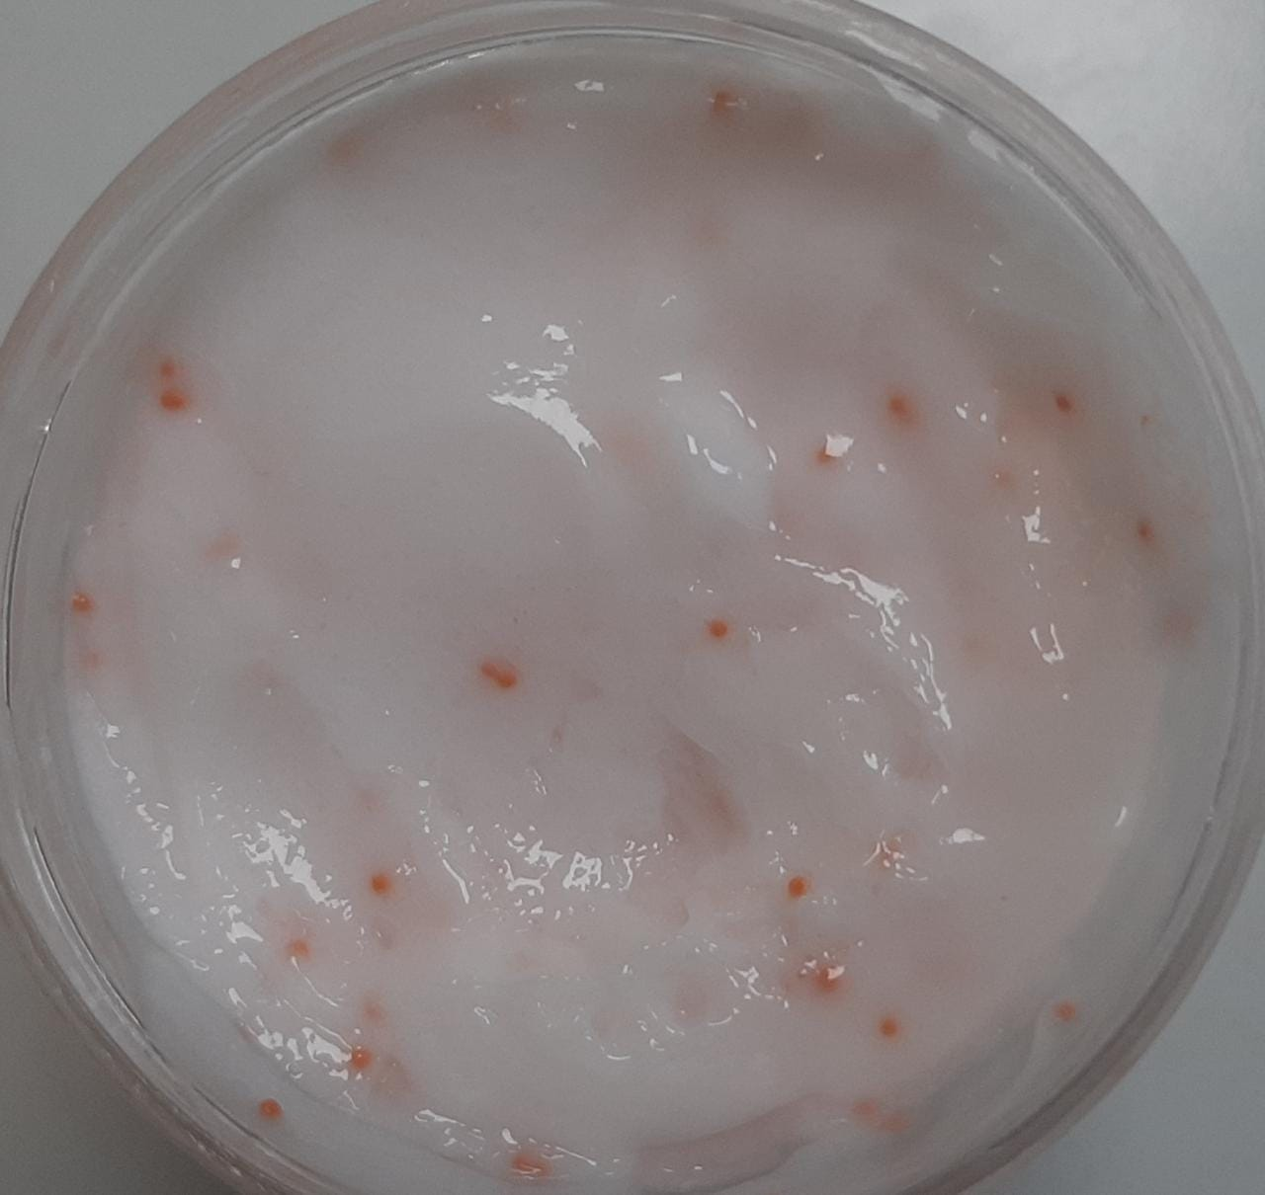
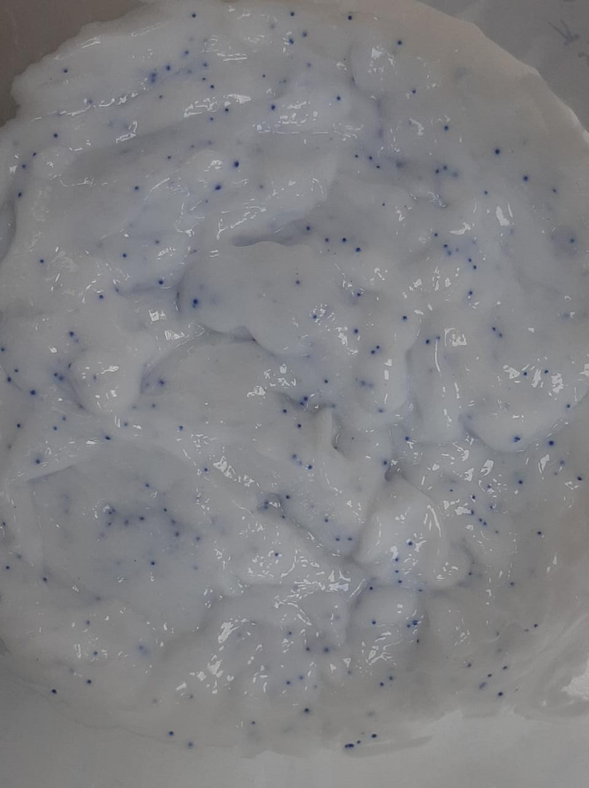
Samples with HB50 Formulation:
0.75% Ester beads(1mm) 0.4% Wax beads(1mm) 1.5% Ester beads(1.5mm)
0.4% Wax Beads(0.4-0.6mm)

Slide 52
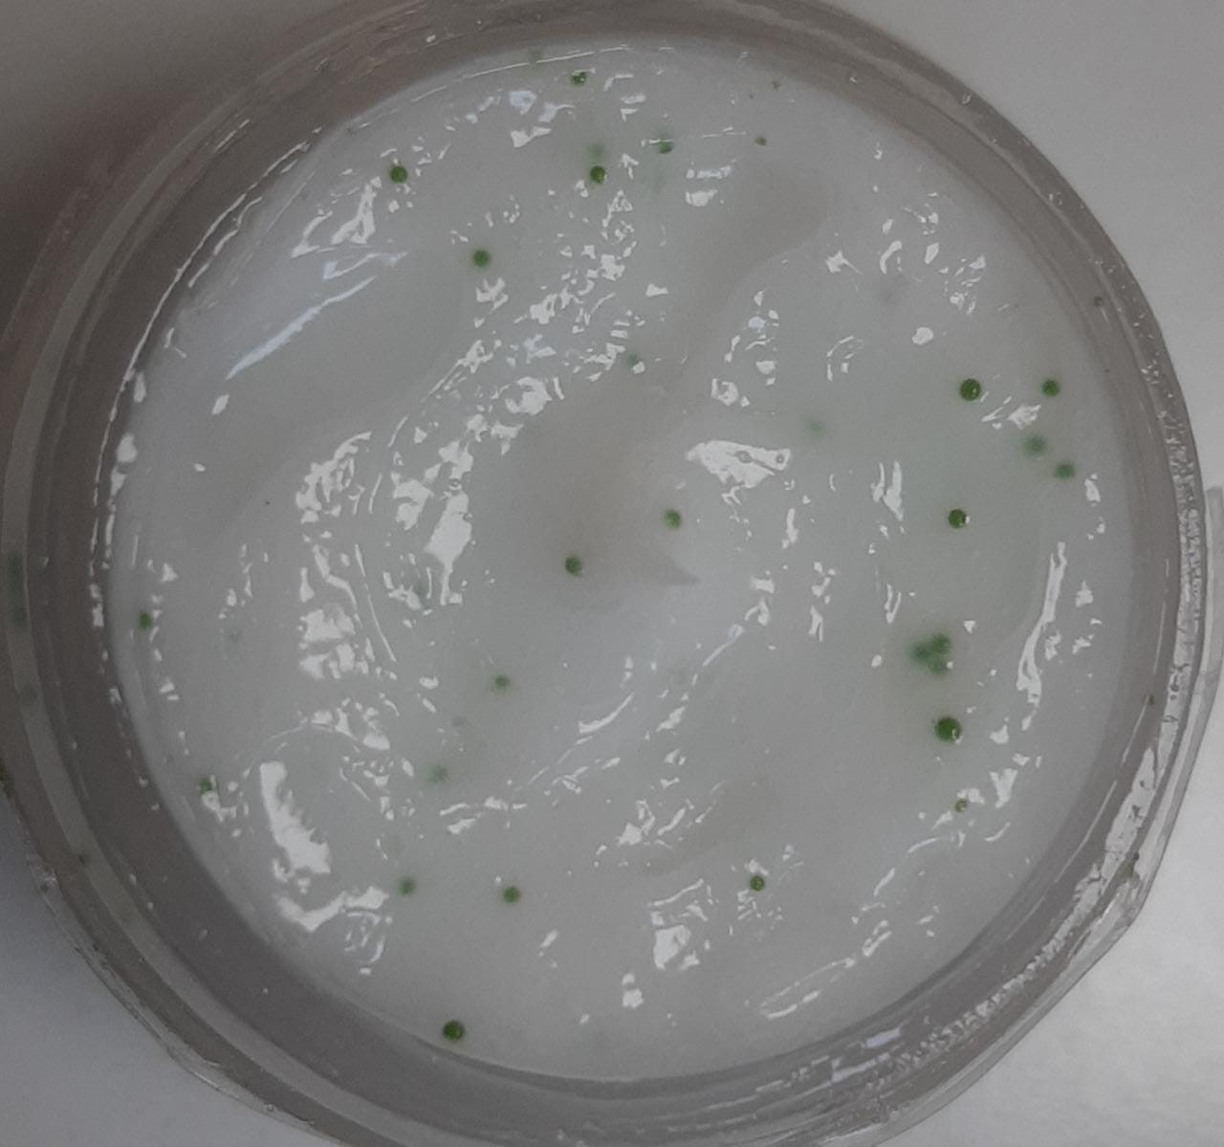
Samples with HU25 Formulation:
0.4% Wax Beads(0.5mm)

Slide 53
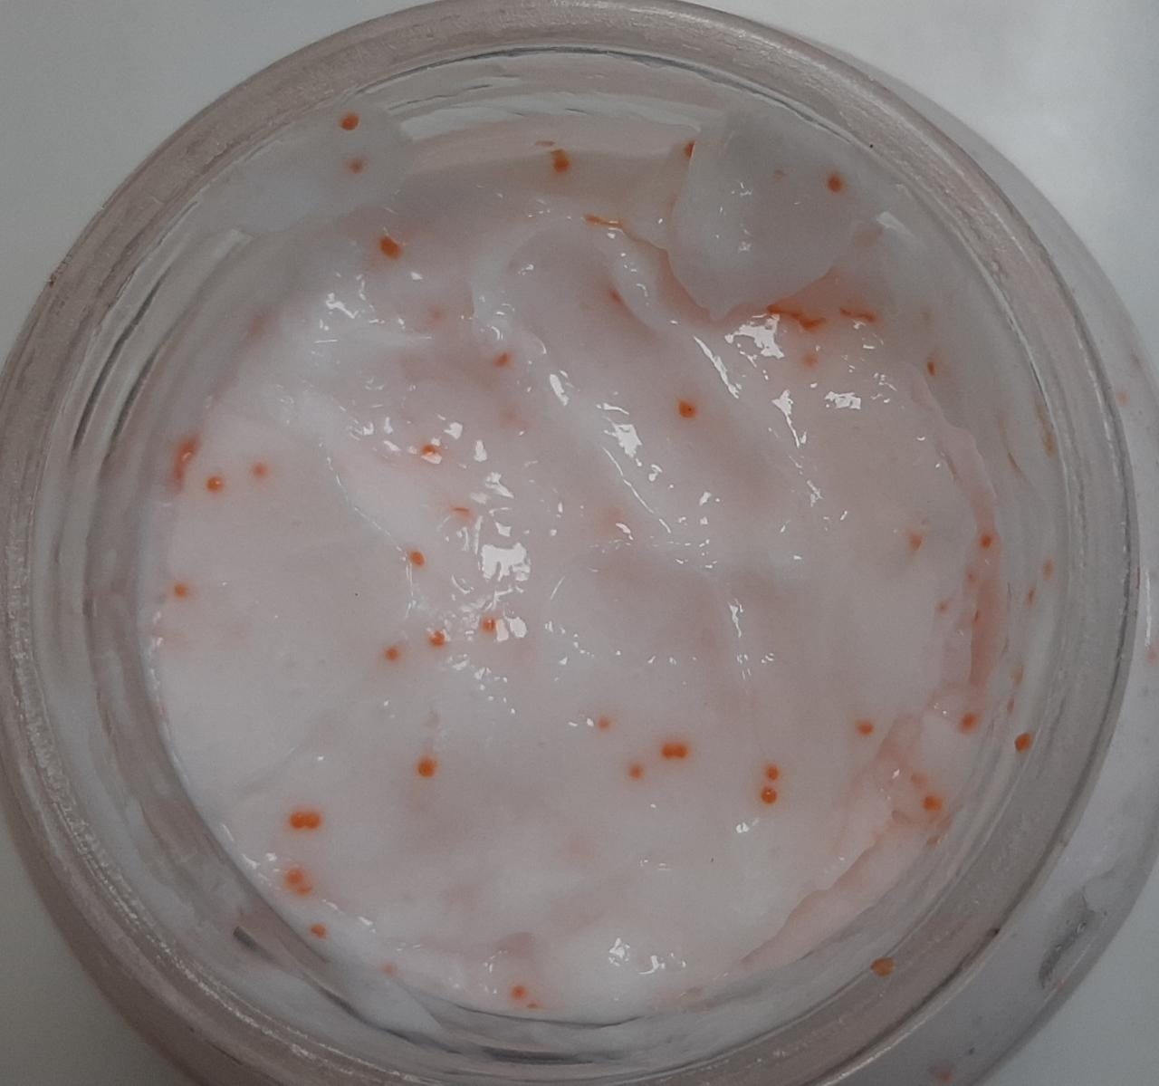
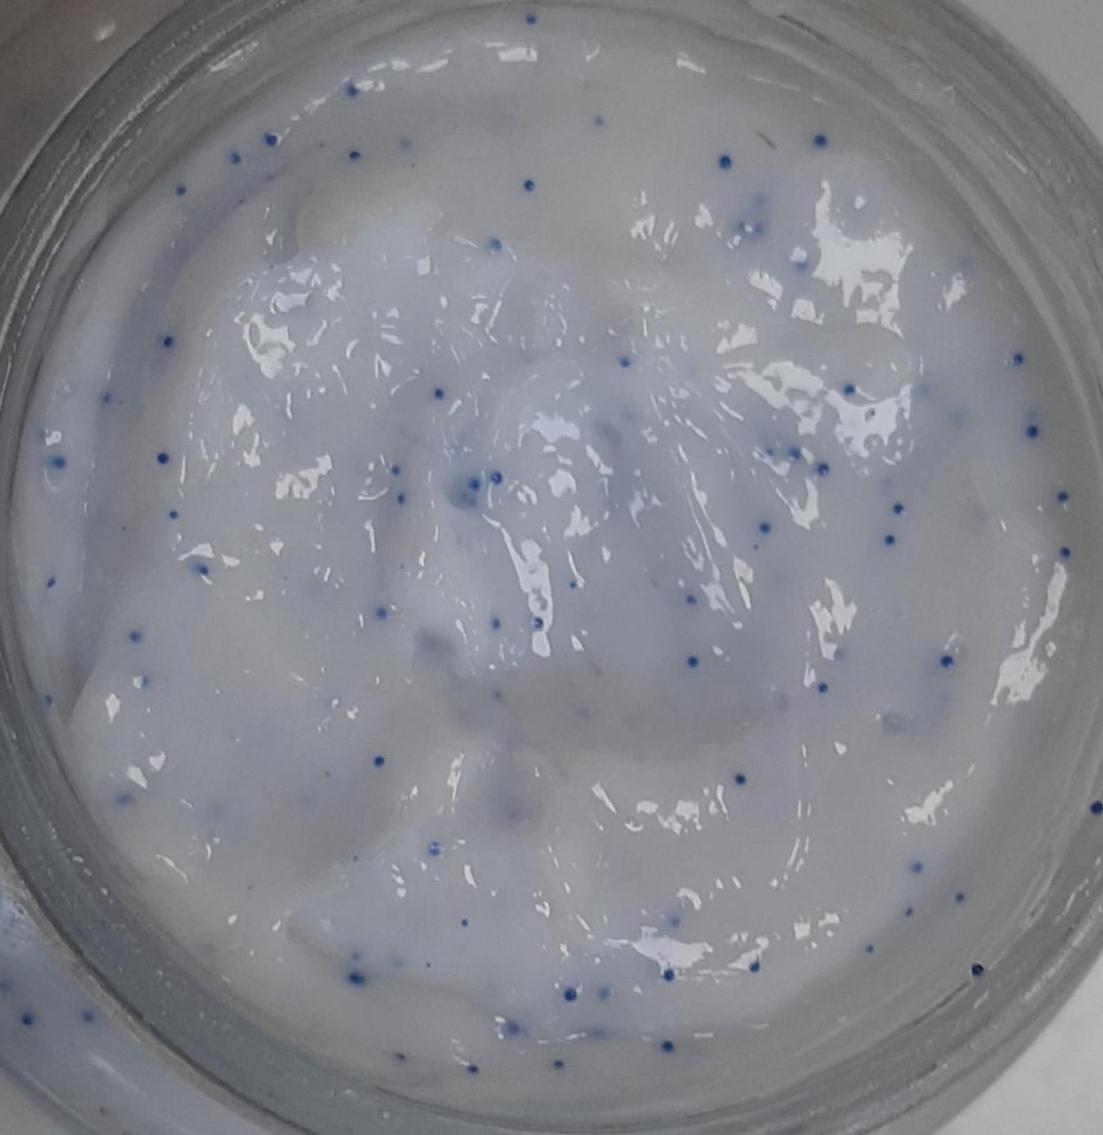
STABILITY RESULTS OF SAMPLES:
After keeping the samples in the 45C for 3 weeks, the following are observed:
No color leaching for both the samples
No change in the texture
Jojoba ester beads are breakable while rubbing
The cirebelle wax beads are unbreakable as it was
0.75% Ester 0.4% wax
Pictures after 4 weeks at 45C

Slide 54
CTI:

Slide 55
Sensory Test:
Parameters to evaluate:
Ease of dry combing
Frizzfree
Smoothness
Shine
Soft Feel
Test Details:
2 base wash(30s application + 30s wash)
2 non-conditioning wash(30s application + 30s wash)
Mask application(1min application + 2 min leave on + 30s wash)
Constant flow tap water (Sink 2, hair lab)

Slide 56
DV IR (HB50) + 0.75% Florasphere 1mm Jojoba Ester Beads:

Slide 57
DV IR(HB50) + 0.4% Cirebelle Wax Beads:

Slide 58
DVDS(HU25) + 0.75% Florasphere Jojoba Ester Beads:

Slide 59
DVDS(HU25) + 0.75% Cirebelle wax beads:

Slide 60
NEXT STEP FOR SENSORY:
TA for smoothness
HLCR for damage
CryoSEM for microsheet structure
XRF

Slide 61
Analysis and Direction:
The beads are unlikely to affect the sensory for both microsheet and non-microsheet formulations. Moreover, it can enhance them if we use ester or encapsulated beads
The main challenge may come in terms of scale up, packaging and costing

Slide 62
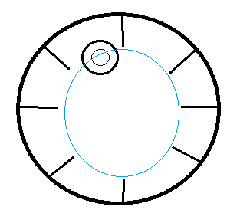
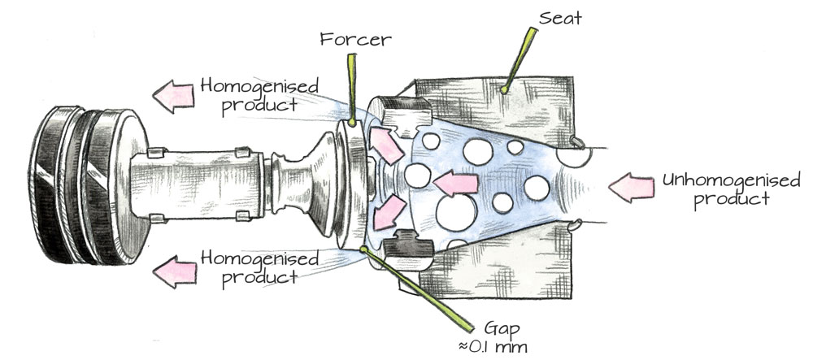
Scale Up:
Design of the BSM:
Mixing with an off-center marine impeller
and the whole vessel is rotated axially.
The product passes through pipe and enters the homogenizer (horizontal) and completes a recirculation loop.

Slide 63
Observation and Direction:
Plan:
Make the entire mask batch first by using high shear and continuous recirculation
In the end, make sure the temperature is ambient and add beads overhead
Run only scrapper and the agitator

Slide 64
Challenges:
Shimmers:
For adding shimmers the cleaning can be challenging:
- Acid + alkali + water wash is one of the ways
Not economically feasible
Beads:

Slide 65
Result:
…

Slide 66
Cost Details:
The tentative cost of the Florasphere jojoba ester beads are about 16000-23000 per kg. The analysis is made taking the max value.

Slide 67
Next Step and Direction:
Optimize the color of the beads:
Optimize the cost:
More consumer test and analysis the results:

Slide 68
Drag on a spherical particle in viscous fluid:
The hair mask is a non-Newtonian fluid. For non-Newtonian fluid the drag coefficient is given by –
Cd = 24/Re * X(n) where Re = Reynolds number and X(n) is some non-linear of function of index of power law model, n.
Drag force, F_{d} = ½ Þ . U² . Cd
Now, Re = Þ . U. d/v ; Þ = density of liq, U = velocity of liq, v = viscosity and d = diameter of particle
The net drag force F_{d} ~ U.d.v. X’(n)
Now, for flow in pipe, the flow rate Q ~ (∆P)^{1/n} ; ∆ P = pressure difference/pump pressure
As mask is shear thickening fluid n > 1.

Slide 69
Enhancement of Hair Serum with beads and shimmer

Slide 70
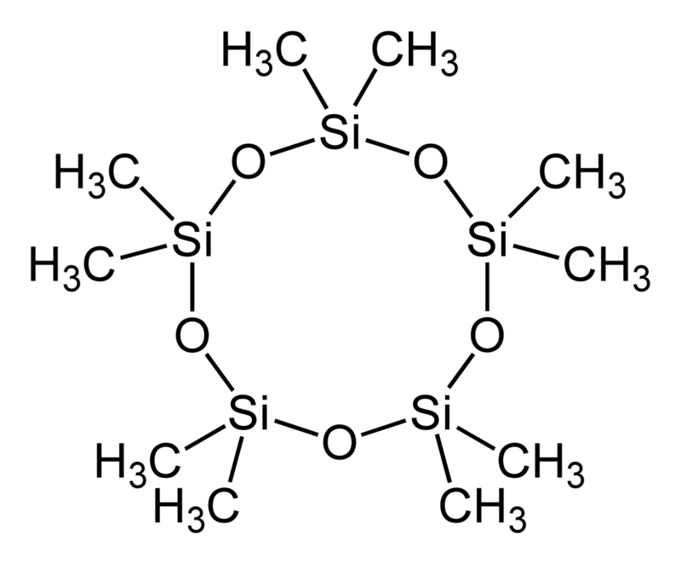
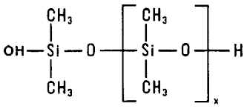
Hair Serum:
Hair care product which gives benefits in terms of smoothness and shine.
DV-IR Formulation:
DC-245(cyclopentasiloxane)(54%):
- transparent liquid
- viscosity: 3cp
- Main function in spreadability improvement.
DC-1501(cyclopentasiloxane + dimethioconol mixture)(42%):
- transparent liquid.
- viscosity: 5500-6500cp
- deposition and smoothness enhancing.
This mixture of DC-1501 and DC-245 gives the best formulation for the hair serum.
Only DC-245 gives powdery feel
Only DC- 1501 gives stickyness

Slide 71
Consumer benefits:
1. With shimmer:
-- enhancement of the product’s appearance.
- Deposition on the hair to serve the glittery effect.
2. With beads:
-- enhancement of the appearance.
-- encapsulation
-- Claims

Slide 72
Conditions for suspension:
1) For any liquid of density Þ _{liq,} viscosity u and a spherical particle of radius d and density Þ _{b}
The settling velocity is directly proportional to d² . (Þ _{b} – Þ _{liq}) and inversely proportional to viscosity v if we assume no interactions.
Hence, minimizing the density difference will help to reduce settling.
The serum’s bulk density is ~0.8 or 0.9 g/cm³
2) The silicone oil in serum formulation is hydrophobic in nature. So, if we use hydrophobic beads the interaction may help the suspension.

Slide 73
Beads:
Based on the requirements above I’ve tested with the following beads:
Cirebelle wax beads:
- cirebelle fine chemical
- size: 425 – 800 micron
- color: Blue
- Specific Gravity: 0.85-0.92
2. Jojoba Ester beads:
- Floratech company
- size: 1mm
- color: Orange
- Specific Gravity: 0.85-0.92

Slide 74
Movement of single bead in serum:
If we put a single wax bead in the serum formulation, we can observe:
The beads are moving randomly up and down at about 0.2-0.3 cm/min.
Eventually it will settle down at the bottom or at the surface of the wall or air silicone interface.
Explanation:
The main governing force here is hydrophobic interaction between the serum and the beads. The effect of gravity is much less here as the density of both beads and fluid are roughly same.
From energy point of view, we can say that when the bead is at the surface of wall or interface with air, its free energy is minimum and so it sticks to that place.
If there are multiple beads together, there are interaction between them as well which promotes aggregation and further settlement due to weight.

Slide 75
Ways of suspending beads in hair serum:
With the explanation mentioned above there can be two ways to solve this problem:
1.
Irrespective of the nature of beads, if we find some cross-polymer or suspending agents or thickeners which can make a 3d network then the beads can be trapped into them and stay suspended.
So, we need to scout materials which satisfy the following conditions:
It is compatible with DC-245
It makes the solution transparent or little hazy but not completely opaque.
It does not increase the viscosity more than 50% or change the rheology to gel like substances.
2.
The other way to solve it is the using some surfactant.
In this case, let’s think the beads as a separate phase all together. So, if we use beads with hydrophilic coating(mica, TiO2) and we have silicone oil which is hydrophobic, we can use some surfactant to disperse the beads in silicone.
Then the problem can be thought of an emulsion formation or dispersion problem.

Slide 76
How do suspending agents work?
Entanglement: In this procedure polymer chains are dissolved in a solvent and entangles like soft, cooked spaghetti. Solution viscosity increases as the chains wrap around each other.
Cross-linking: Cross-linking polymers, that have two functional group which can interact with each other and help in making a 3d network structure in some compatible solvent.
Cluster formation : In this case, grafting the hydrophobe along the length of the hydrophilic backbone is achieved. The hydrophobic domains behave like surfactant hydrophobes and due to entropy optimization the they form cluster which help in increasing viscosity.
Suspending agents:
PEG, Carbopol Polymer, Acrylate Copolymer/ Carbomers But all of them are compatible with aqueous
system.

Slide 77
Control Sample: DV IR serum
Formulation and processing:
Now, we have devised series of experiments with different agents and all the observations are noted as following.
NOTE: Miss DV LLF2 which was used as perfume in original DV IR formulation is removed as it is making the serum opaque.
Material Description | Process | %
DC-245 | In main vessel - Mix all the ingredient one by one following continuous stirring - for 15 min | 57.87
DC-1501 | In main vessel - Mix all the ingredient one by one following continuous stirring - for 15 min | 42
Olive oil |  | 0.01
Vitamin E |  | 0.01
Triple protein Vegan Keratin |  | 0.01

Slide 78
The general outline of each experiment can be devised in the following way.
Let’s call the new agent(thickeners or suspending agent) = X.
Now, the process flow can be broken into 2 phases as follows.
After mixing the Phase C, add beads of the given concentration.
Phase | Material
Phase - A | DC-245 + X
Phase - B | DC-1501 + others
Mix Phase A in the main pot.
Mix Phase B in the side pot.
Phase C = mixture of Phase A + Phase B

Slide 79
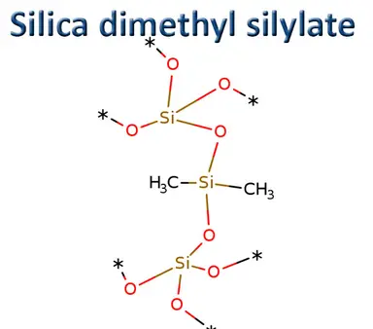
X = VM-2270.
INCI: Silica Silylate
Description:
This is white free-flowing powder capable of absorbing non-polar and polar oils.
Ways of processing:
The first step is to disperse it into a low molecular weight silicone and add the pre-mix to the other formulations.
Also, we need to apply high shear force to break the aggregation and agglomerated particles.
Mechanism it works:
This powder particles are supposed to have a silane coating on them which have –OH group. This hydroxyl groups interact with each other with the hydrogen bonding and help in making the 3d network.
Although the product is supposed to be thixotropic in nature as the H-bonds are weak.

Slide 80
Exp set - 1:
Variable concentration: VM-2270, DC-245.
Beads concentration: 0.1%
Other concentration: same as the control sample.
Purpose:
- To check whether the suspending agent gets dispersed in the DC-245 and able to suspend the beads
Processing details:
For each of experiment, the stirrer speed and time of mixing are the main variables.
Also, there are few exp where more changes are done. They are mentioned in the table.
Mixing device: Overhead stirrer.
In the experiments, the process details slightly varied to test few situations. The exact process details, the initial, final observations, and the final picture after a week are gathered in the next table. shown.

Slide 81
Results:

Slide 82
Results:

Slide 83
Exp set - 2:
Variable concentration: VM-2270, DC-245.
Beads concentration: 0.05%
Other concentration: same as the control sample.
Purpose:
- Whether the beads interaction can be optimized and the make a stable suspension
Processing details:
- The Phases are same as before. They are mixed with different rpm according to the table.
- For the last experiment the VM-2270 was mixed as a slurry so that it will mix easily.

Slide 85
CONCLUSION:
The silica particles of VM-2270 are not staying dispersed uniformly in the silicone medium even if we use high shear force of 3000 rpm.
Even if it gets dispersed in the media, it’s making the solution hazy and that won’t be allowed if we want to suspend beads.
Explanation:
The reason of opaque solution is the scattering of light due to silica particles. That is the silica particles are not dispersed well enough in the solution and that creates the haze.
The bead are well suspended in the portion where the VM-2270 is present though due to opaqueness one can’t make too much difference.
The reason why most of them are floated on the surface is due to phase separation or settlement of VM-2270.
So, in the final picture, we have VM-2270 settled down at the bottom covering 1/3rd -2/3rd of the container and some beads are suspended there.
The above 1/3rd portion is free of VM-2270 and the beads are behaving same as 0% VM-2270 sample.

Slide 86
Exp set - 3:
Variable concentration: VM-2270, DC-245.
Shimmer concentration: 0.03%
Other concentration: same as the control sample.
The shimmer is settled down 1/3rd from the surface but if we shake it, it is easily mixed. Hence no sticking to the surface.

Slide 87
Experiments with polymers:
Here, I’ve collected few more experiment details where various X (suspending agents or thickeners) are used.
They all are failed experiments due to incompatibility with DC-245.
The general outline of processing is the following:
Step 1: Melting the polymer at high temperature.
Step 2: Heat the DC-245 upto 50C
Step 3: Mix them together
Step 4: Add DC-1501 and other ingredients.
These polymers are compatible with some oils or tryglycerides. So, in the formulation we included those as well to make it more compatible.

Slide 89
Conclusion:
All of the above polymers are incompatible with DC-245. Also, they require some other oils or glycerides to get dissolved which can affect the final formulation of the hair serum and the sensory results as well.

Slide 90
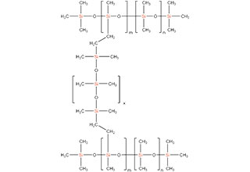
X = DC-3901.
INCI: Dimethicone and vinyl Dimethicone cross polymer
Description:
This is a high molecular weight cross polymer.
Ways of processing:
This material has stringiness and before adding it to the final mix, we need to dilute it. We can use DC-245 for dissolving it.
Also, with increment of shear force the degradation takes place. Hence, we should not apply high shear rather increase the process time of mixing.
Mechanism of work:
The cross linking is supposed to set the 3d network structure and as it is transparent in its original form. So, it is supposed to make the solution clear and transparent.

Slide 91
Exp with silicone cross polymer:
Variable concentration: VM-2270, DC-3901.
Beads concentration: 0.1% (cirebelle wax beads, green, size: 400- 800 micron)
Other concentration: same as the control sample.
Processing details:
Phase A = DC-245 + DC-3901
Phase B = DC-1501 + others
Phase C = Phase A + Phase B
Phase A is mixed with 300-400 rpm till the dilution of DC-3090 (around 20-30 min)
Phase B is mixed at 200 rpm separately in the side pot.
Phase C is mixed at 600-1000 rpm for 30 min.

Slide 92
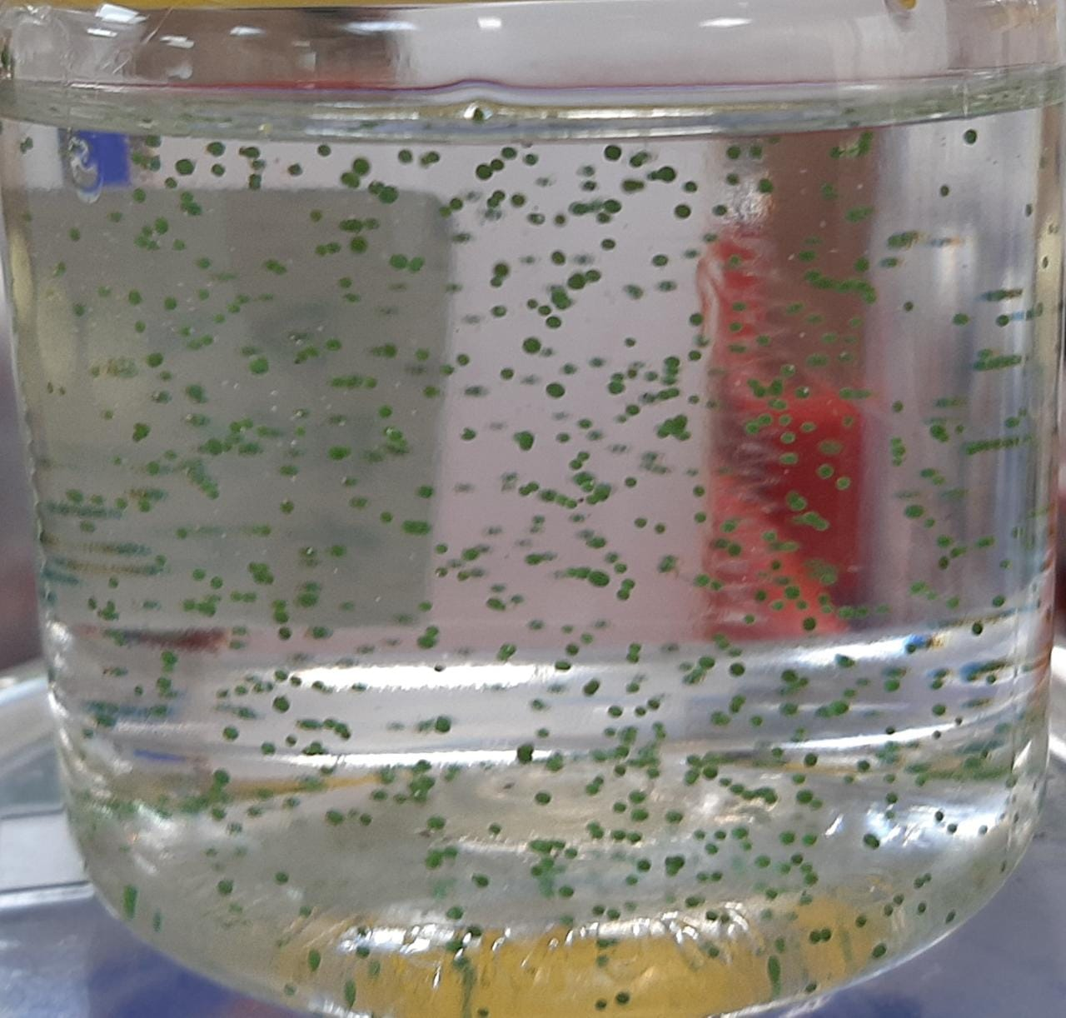
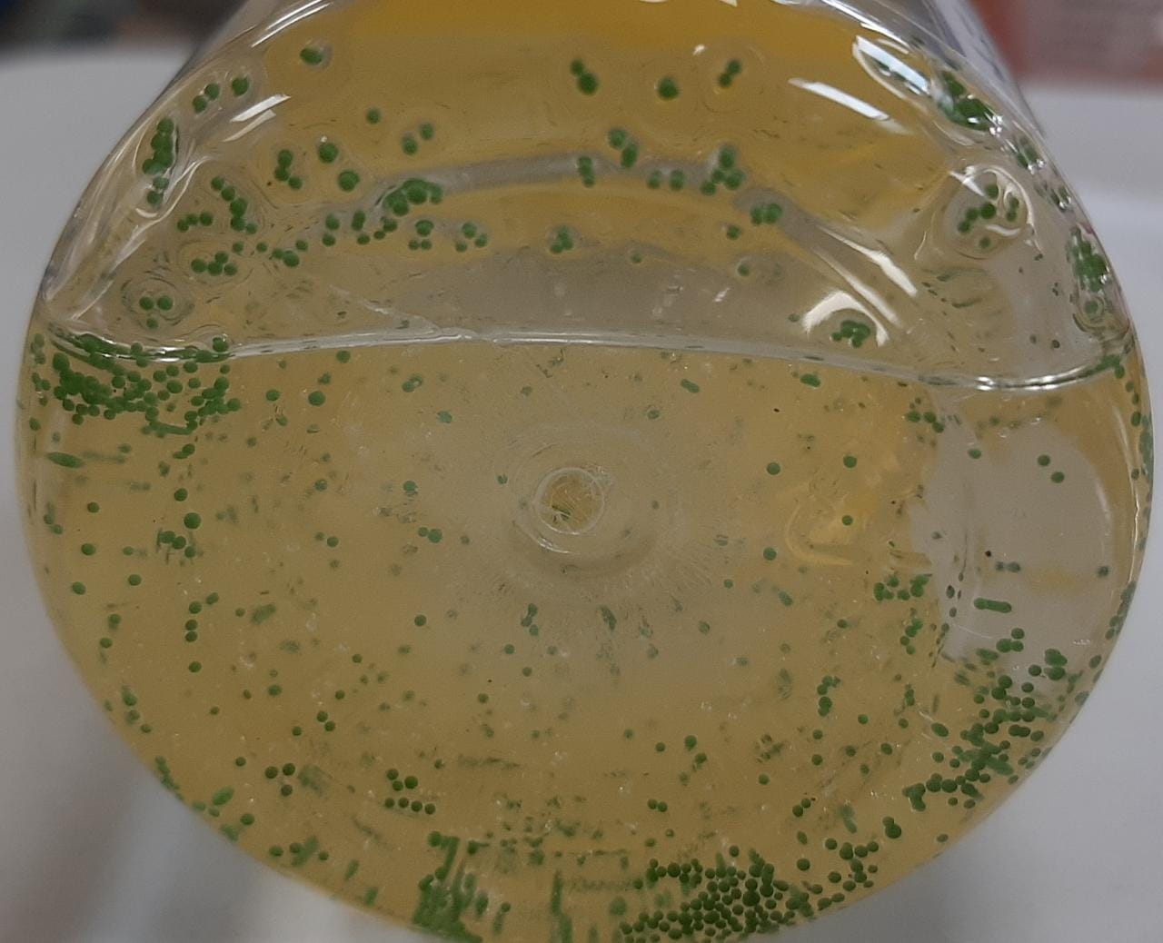
Result with 10% DC-3901:
Initial Final
It’s giving transparent solution.
After 1 day, all the beads are settled at the bottom of the surface.

Slide 93
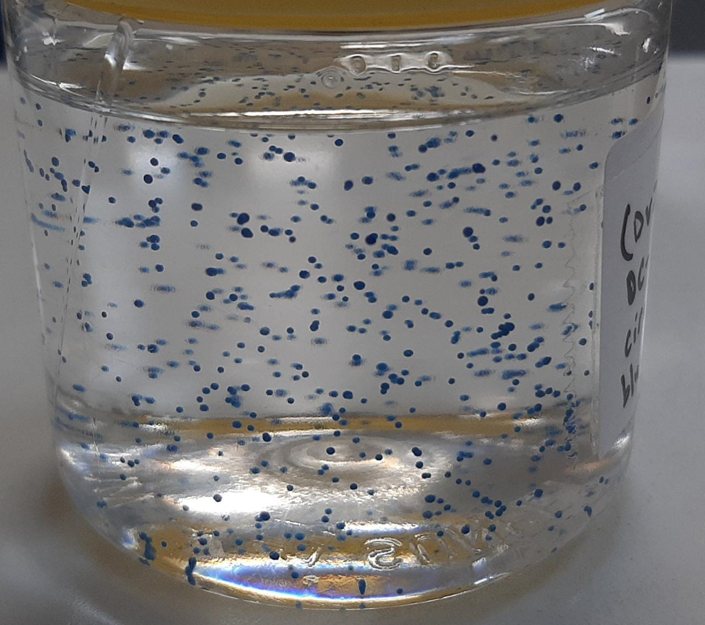
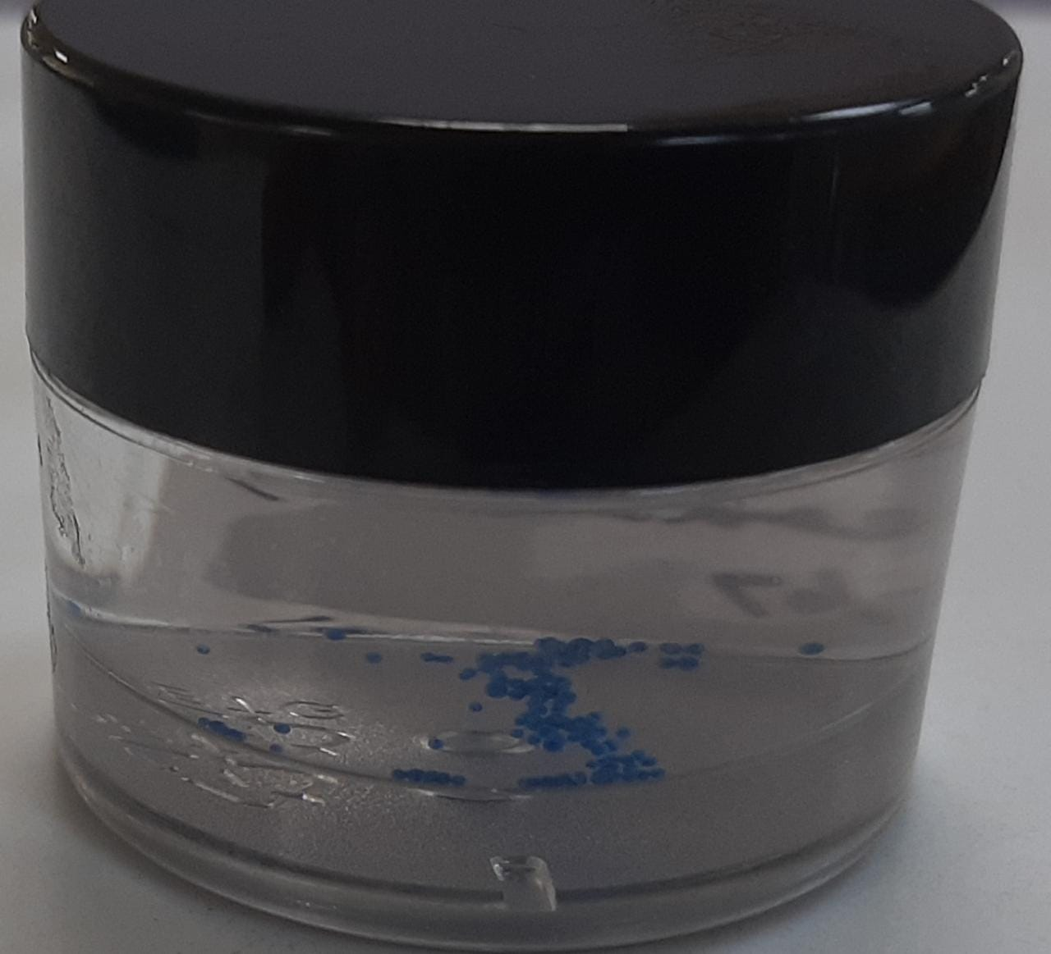
Result with 5% DC-3901:
At RT after 3 days At 50C

Slide 94
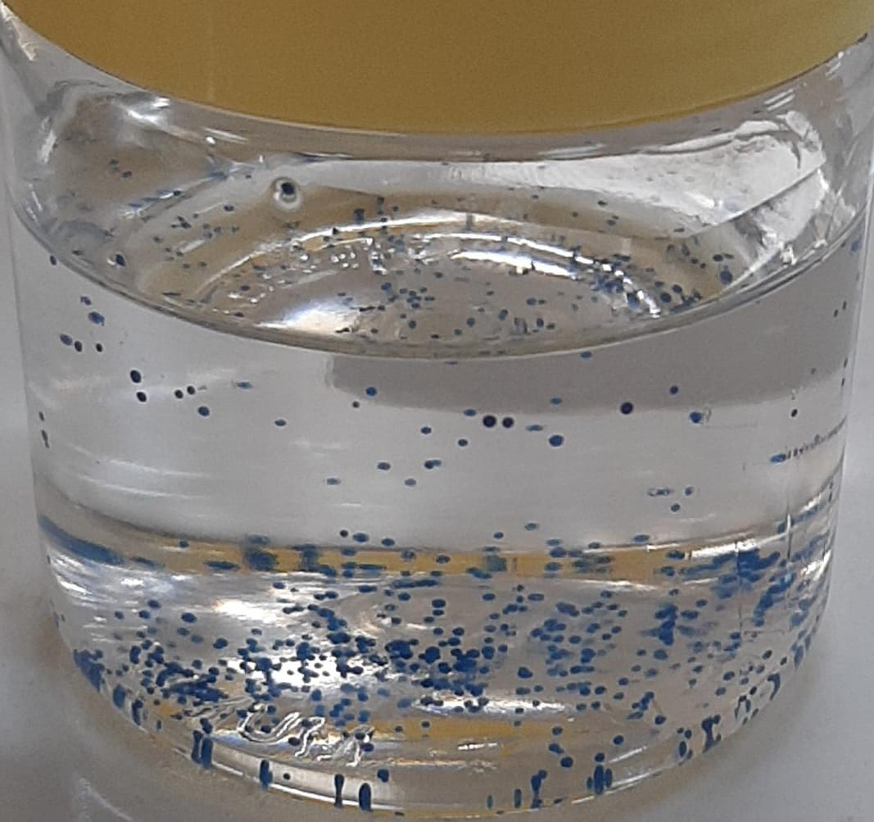
Results after 5 days:
As we can observe after 5 days,
the beads are settling down rather than
floating up.

Slide 95
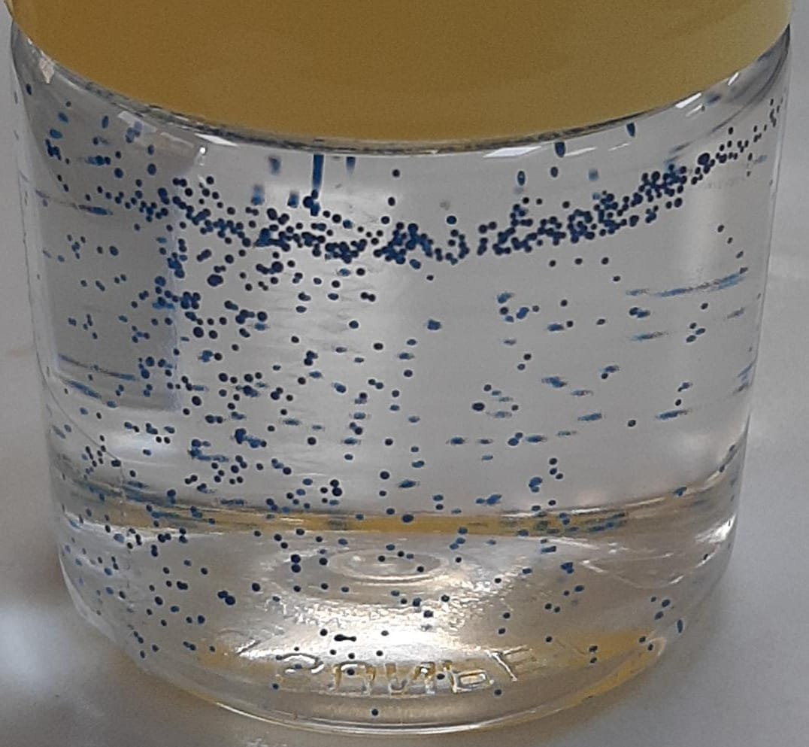
Results with 2.5 % DC-3901:
With less concentration of DC-3901, it is observed
that the beads are floating up though there is
not any phase separation like VM-2270

Slide 96
Explanation and Direction :
One possible explanation of why at 50C the beads are settling down can be the change in density due to temperature increment.
As at 2.5% the beads are floating and at 5% they are settling down with some of them floating(after 5 days), it is possible that the optimum value of DC-3901 is between 2.5% - 5%

Slide 97
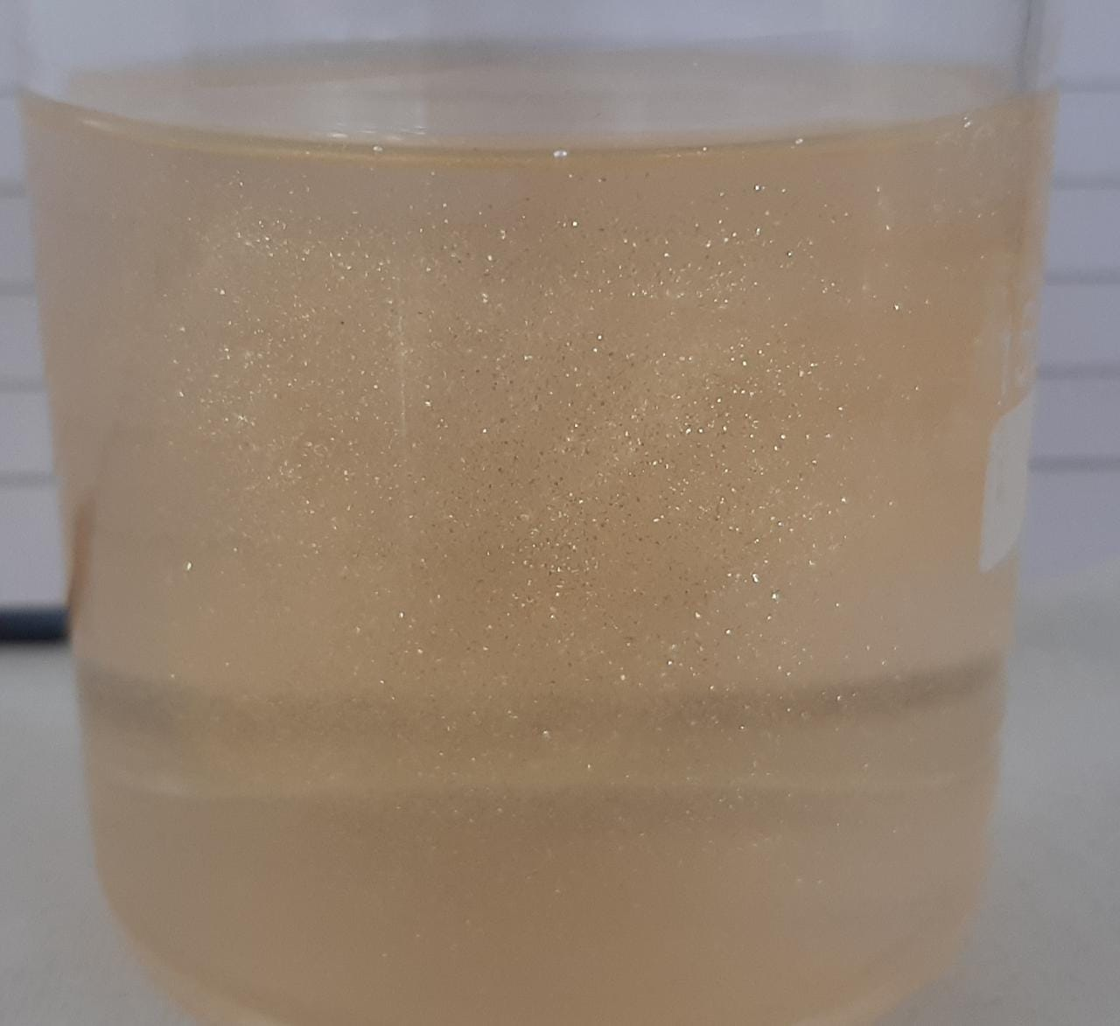
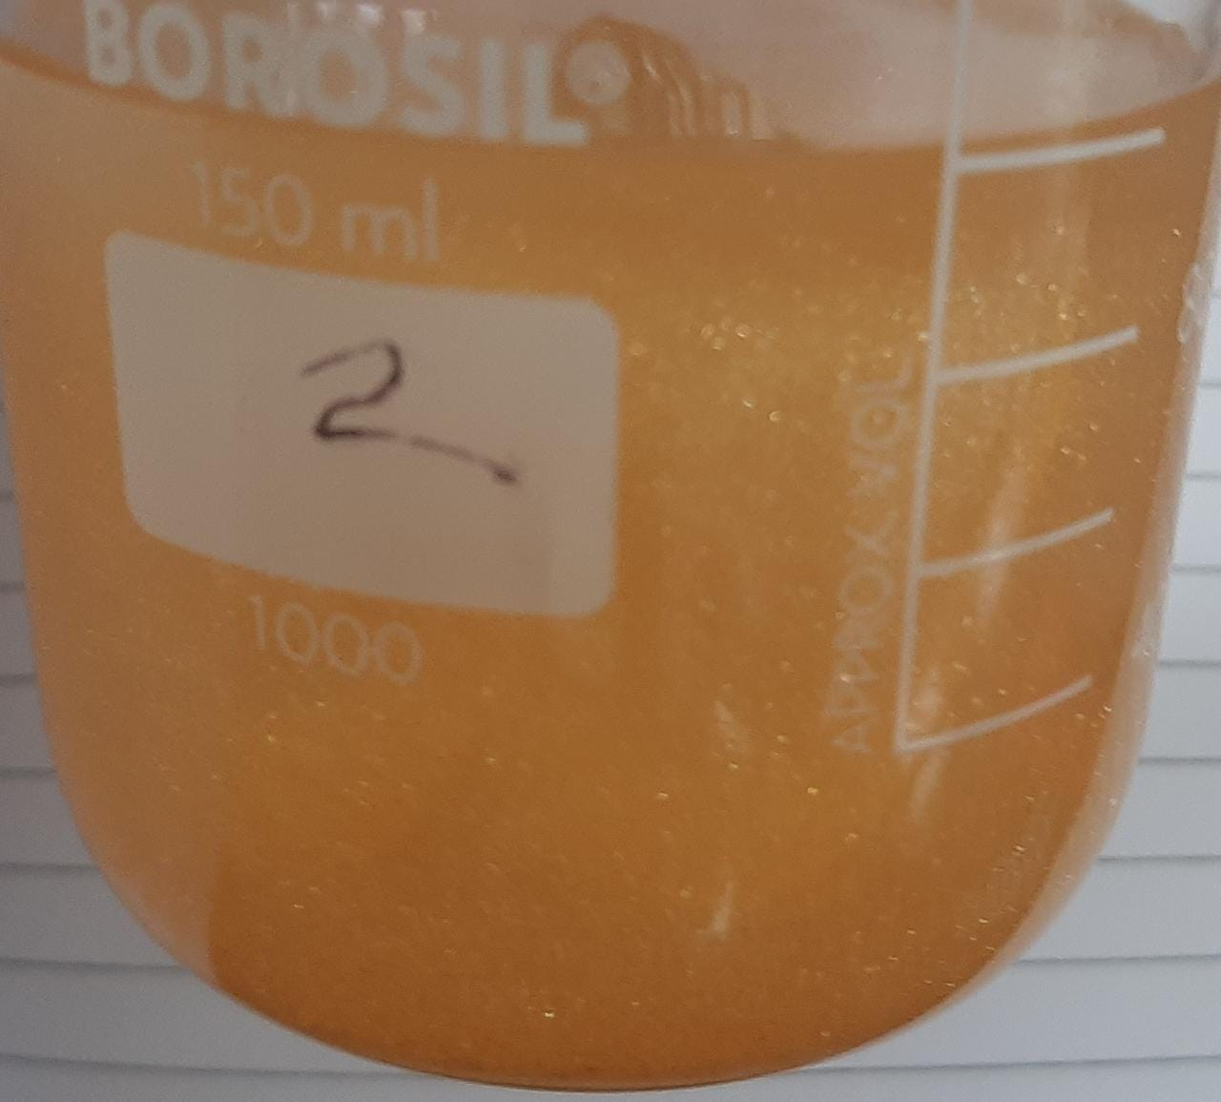
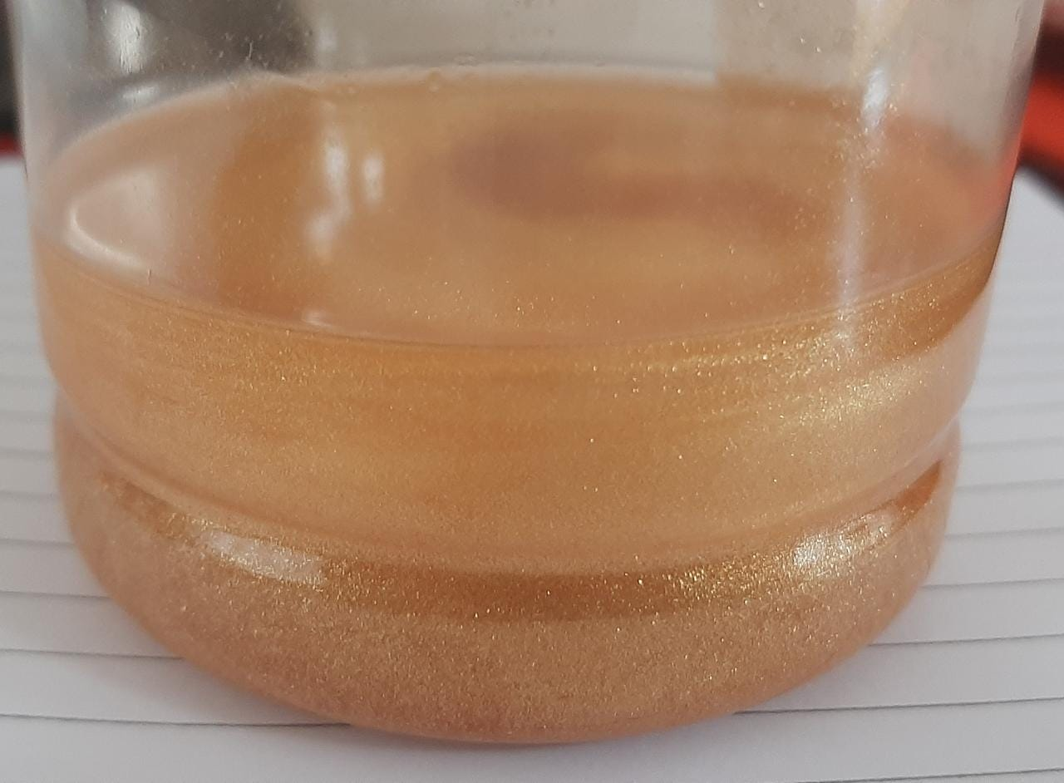
Samples with Shimmer:
Karat Gold MP-24 with 5% DC-3901 First Day:
0.01% 0.1% 0.5%

Slide 98
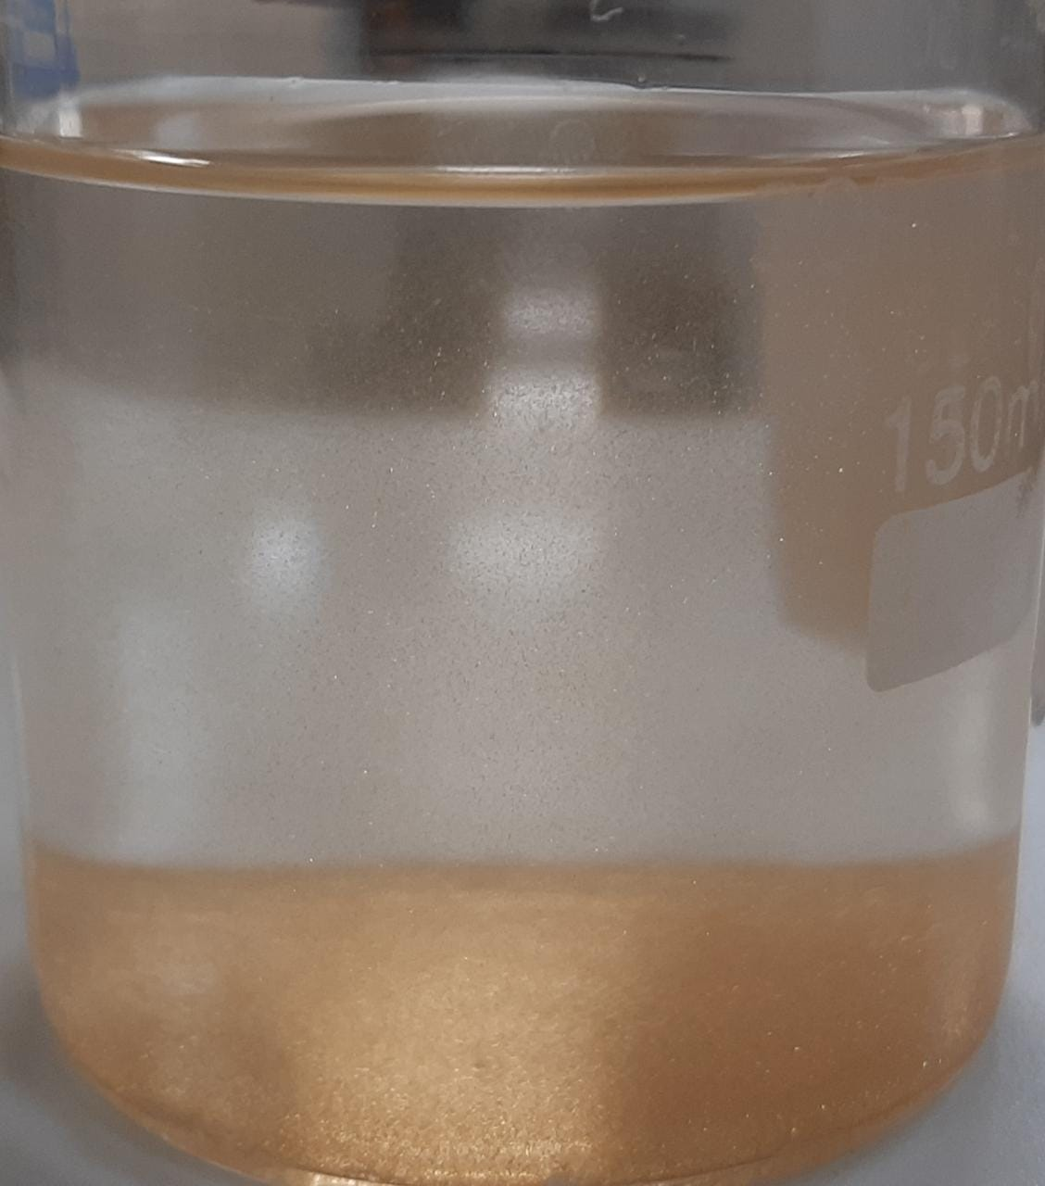
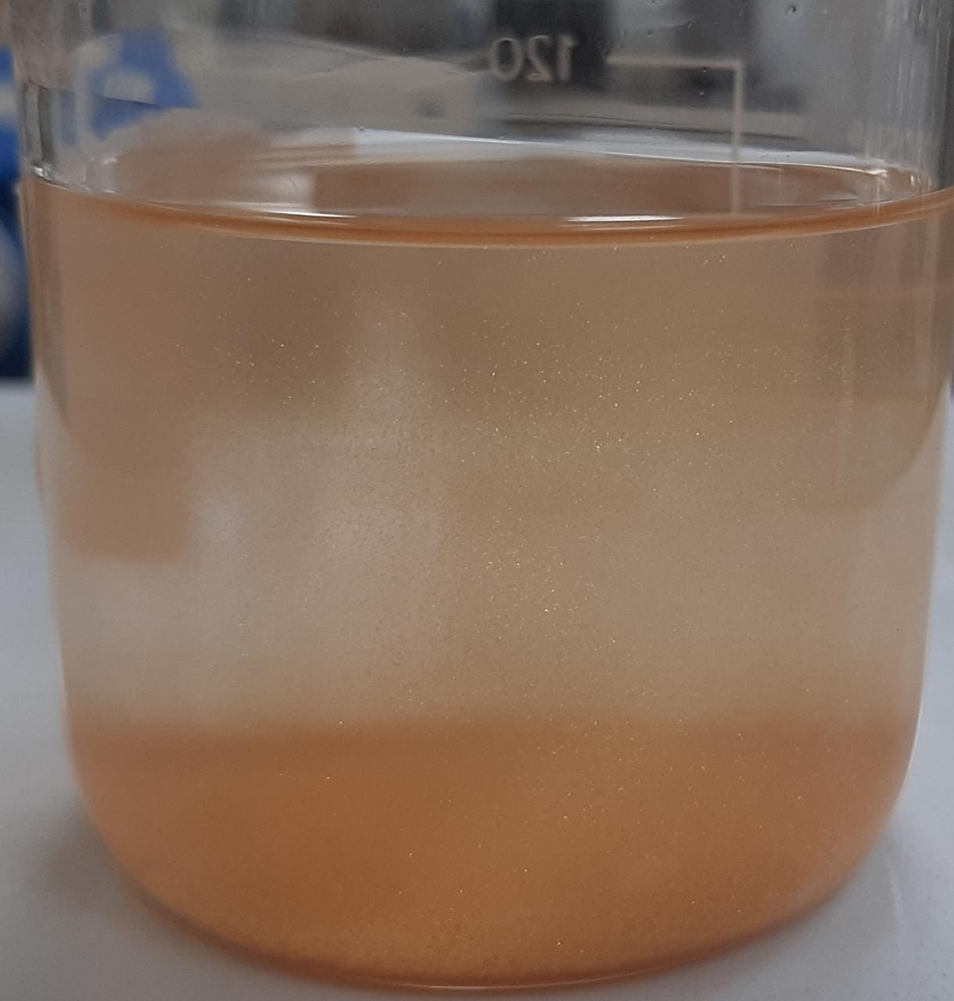
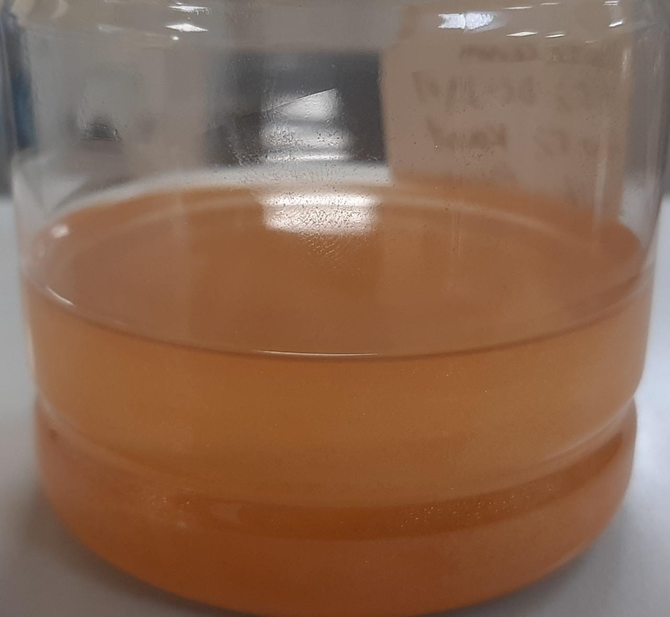
Samples after 1 Day:
0.01% 0.1% 0.5%

Slide 99
Results and Explanations:
As we can observe the shimmers are settled down and stick to the the glass or the pet jar at the bottom.
The reasons for setting down are suspected to be the following:
1. The density of the Karat Gold MP-24 is around 2.7-2.8 g/cm³ which is much higher
than the serum
2. As the shimmers are hydrophilic in nature so less interaction with the silicone system
The reason for sticking to the pet jar or glass:
Mica shimmers or pearls tend to stick to glass or pet jar due to static electrostatic interaction.

Slide 100
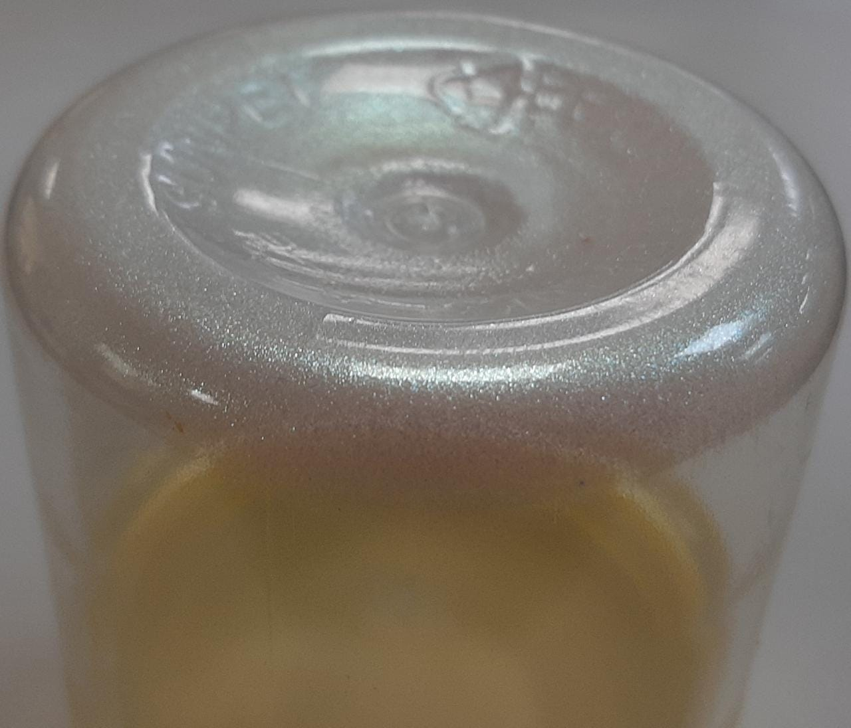
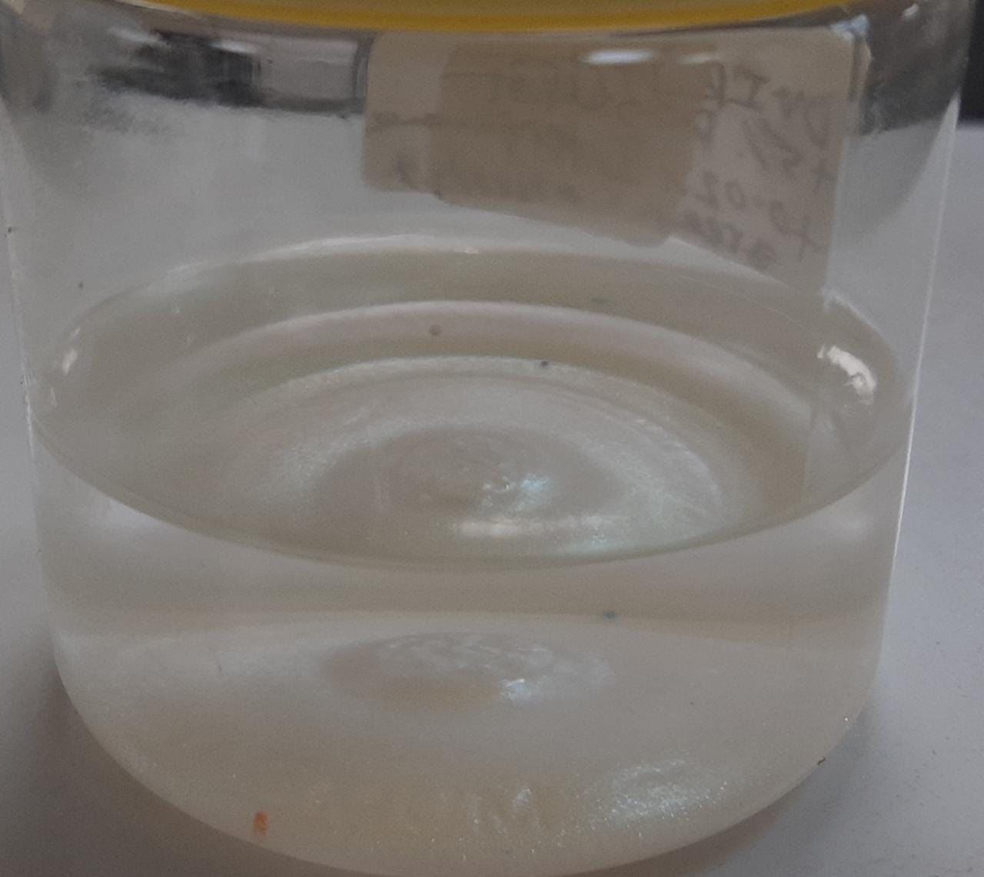
Results with Interference Green:
Now, as it was suspected due to high density the shimmers
Are settling down, I’ve used Interference green with the same
Formuation (5% DC-3901).
The interference green has bulk density about 0.3-0.45 g/cm³
Here we can observe the shimmers still settle down and
Stick to the bottom of the jar.
Hypothesis???

Slide 101
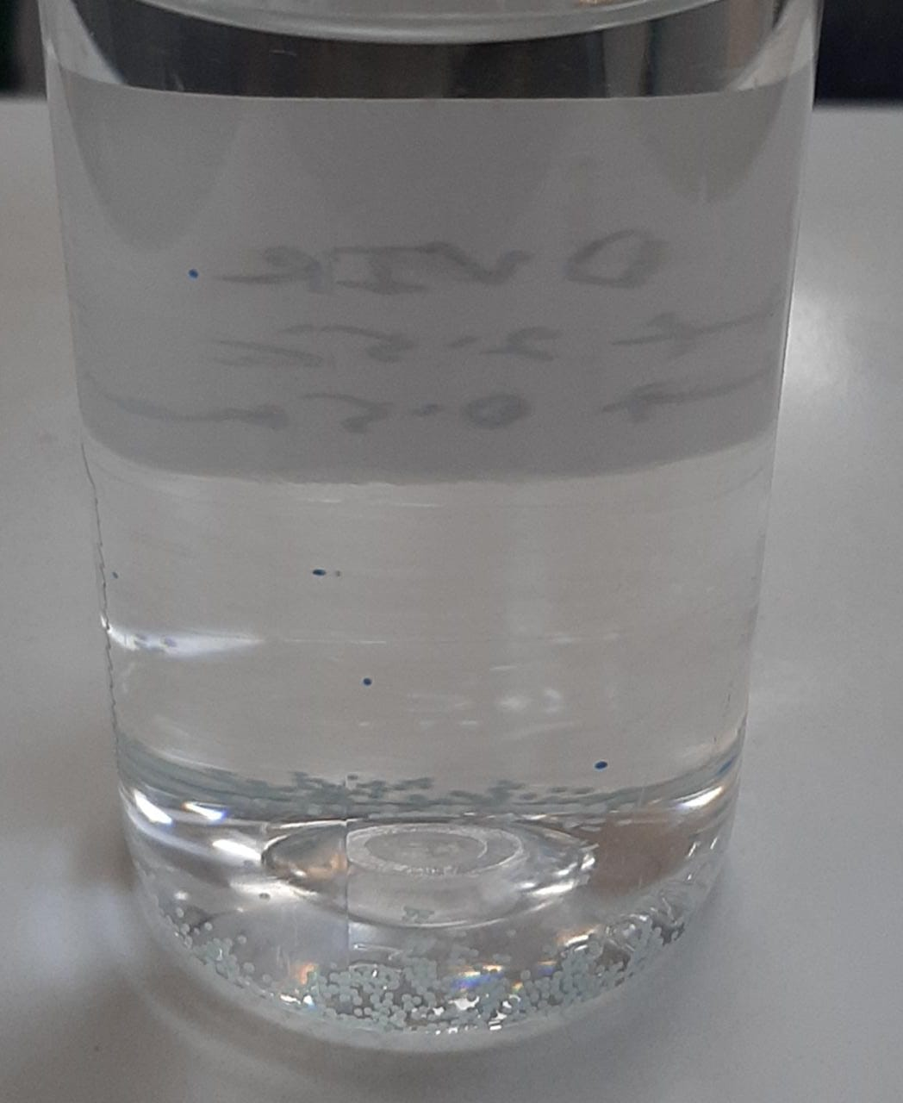
Results with Jojoba ester beads:
With all the experiments done with jojoba ester beads(various size), the results is negative. They always ends up being settled down.

Slide 102
X = Nomocort SG:

Slide 103
Next Steps:
Water based hair serum:
As we have seen there are lot of suspending agents for aqua system, one approach is to formulate a water based hair serum or use any existing water based formulation and try suspending beads or shimmers.
In water base we can also use beads of large size which will stay suspended and the product can be made push and pump type which will enhance the appearance as well.
Cluster formation (as explained in suspending agents working):
If we can find hydrophilic coated beads and choose a suitable surfactant or suspending agent which will function making clusters in the system
Only with color:
Glossy pigments or application of suitable color can create the appealing appearance as
desire.

Slide 105
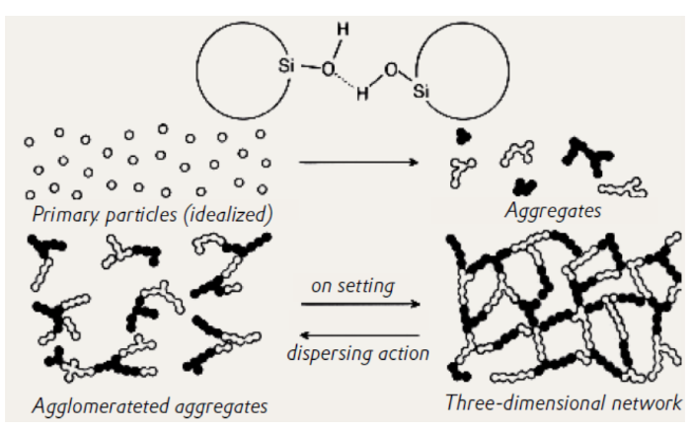
How Does Aerosil Fumed Silica work?
Aerosil is characaterised by silanon(Si-OH) groups on the surface. During dispersion, these groups can interact directly or indirectly with other molecules in the liquid via hydrogen bonding. A reversible 3D lattice structure is produced from this process, which macroscopically, is visible as thickening.
As this process is reversible, subjecting the system to stress (i.e stirring or shaking) breaks down the structure. Accordingly, the system becomes more fluid and the viscosity is reduced. At rest, the viscosity is restored back to the original value as the lattice builds up again. This phenomenon is referred to as thixotropy.

Slide 106
Other ideas:
Automation of mixers:
Just like our little coffee machines with PID controllers.
Automation of RM Details:
Uploading the excel sheet or batch card to a certain program which can easily compute the rm details and keep track of it.
Research Crowdsourcing:
Websites like Math stack exchange where people can post and answer questions. Now as most of the people are busy with multiple projects on their plate, this should start with the UFLP and ULIPs. Soon the data will get enriched and the research environment will be more collaborative than before.

Slide 107
Thank You

